Slide 1
Multivariate Classification and Machine Learning in HEP
Lecture 1
Traditional multivariate classification
Thomas Keck
IEKP KIT
Inverted CERN School of Computing, 29 February – 2 March 2016

Slide 2
Outline
Neyman-Pearson Lemma / Supervised learning
Discriminant Analysis / Analytical methods
Decision Trees / Model complexity
Boosted Decision Trees / Ensemble methods
Support Vector Machines / Kernel trick
Sideband subtraction & sPlot / Data-driven techniques
Available tools

Slide 3
Neyman-Pearson Lemma / Supervised multivariate classification

Slide 4
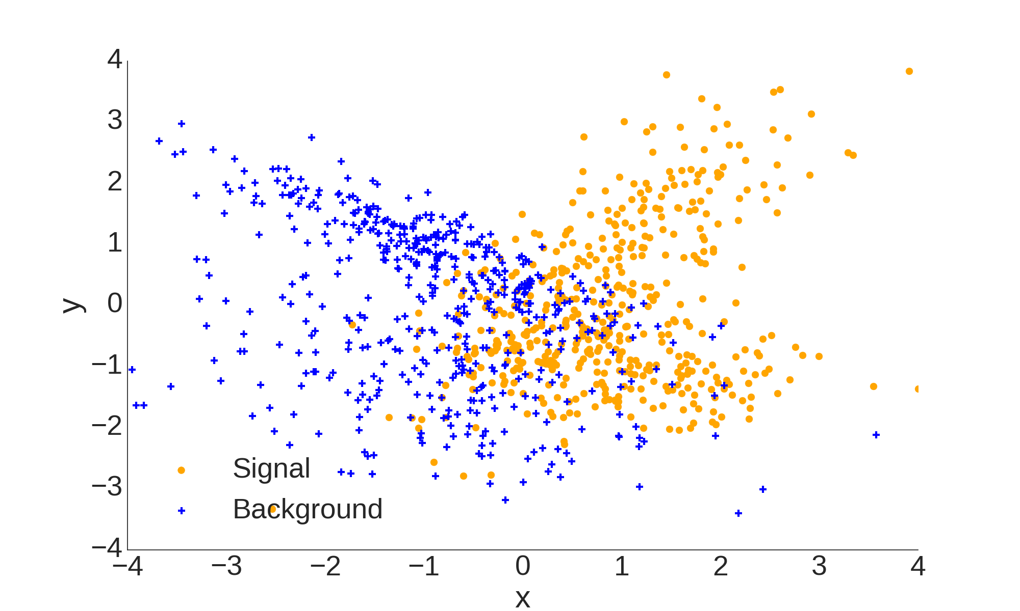
Supervised multivariate classification

Slide 5
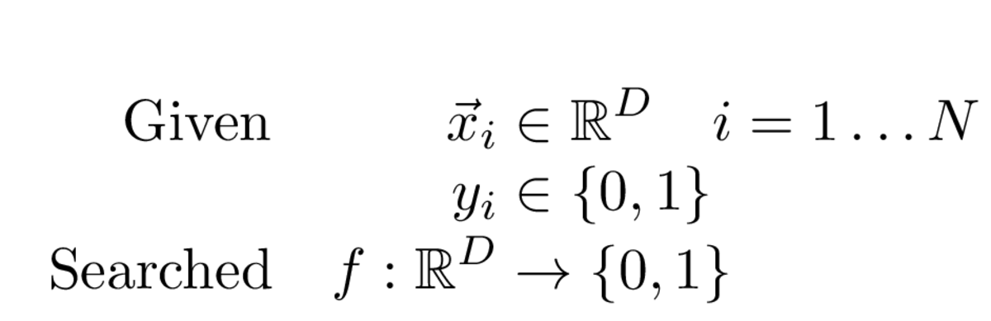
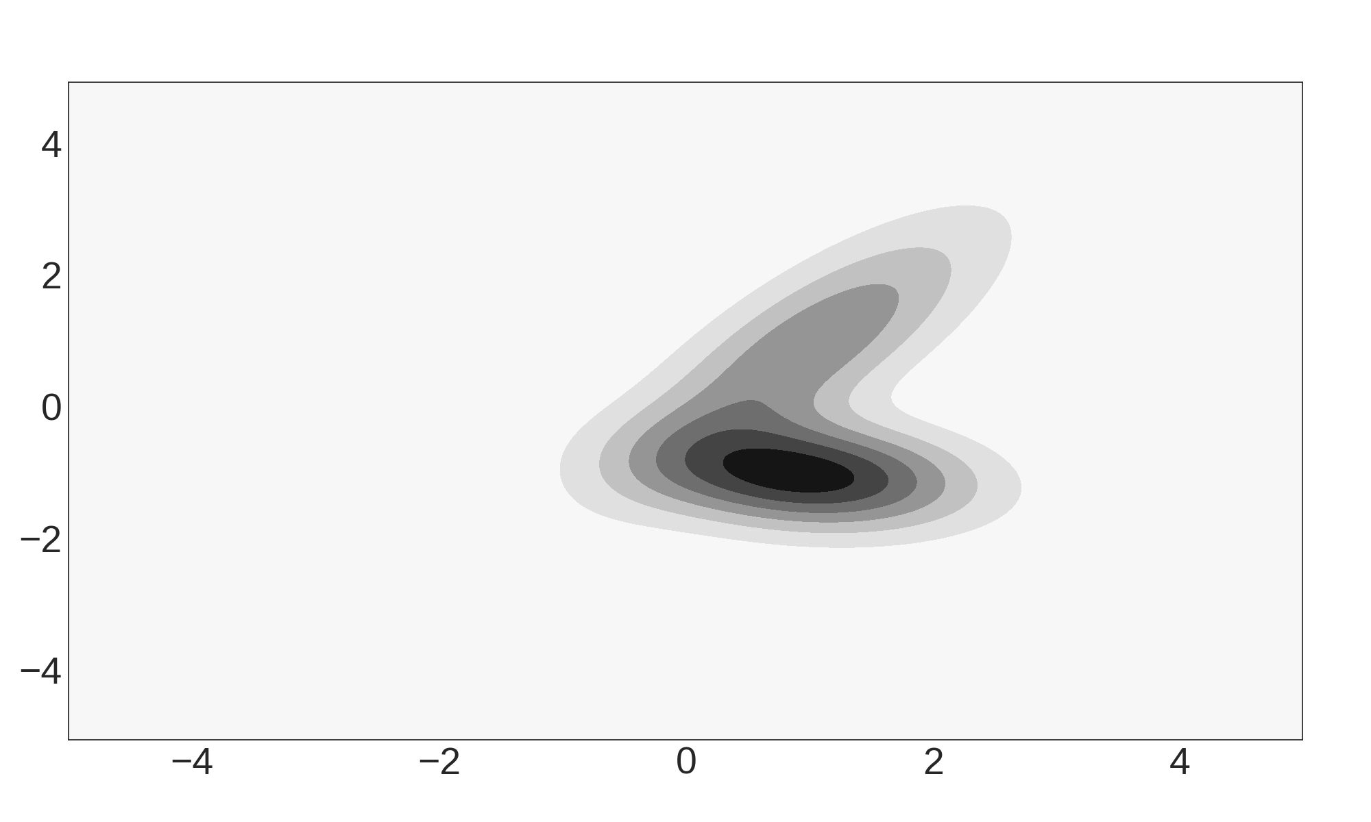
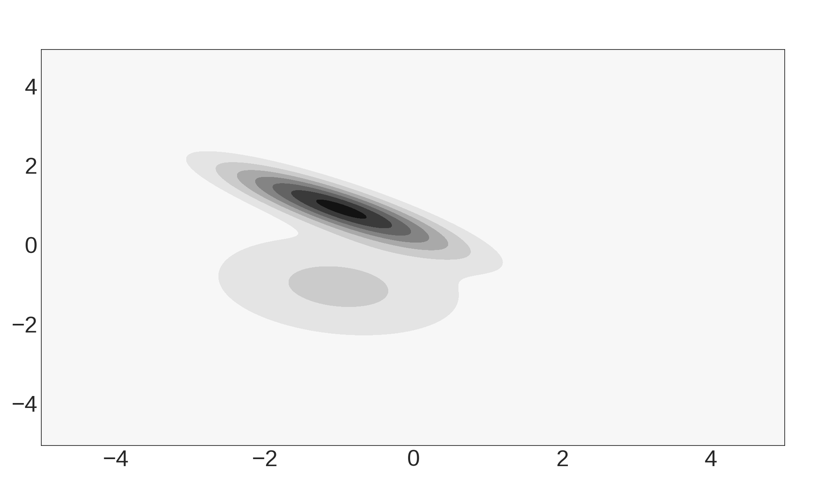
Formal Problem
Background PDF
Signal PDF
PDF (Probability Density Function) see CSC 2015 Data analysis lecture 3

Slide 6
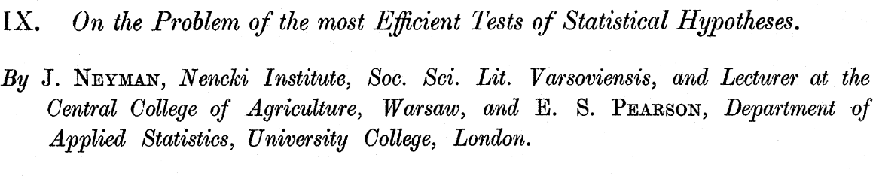
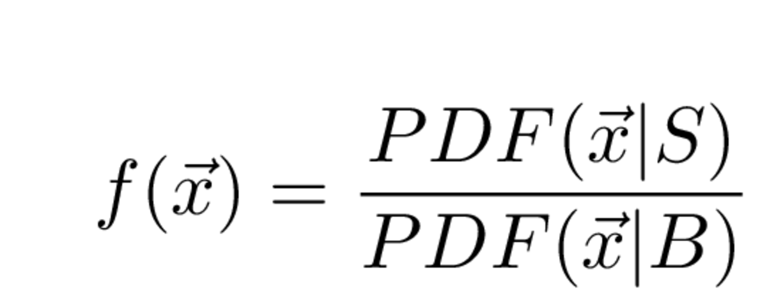
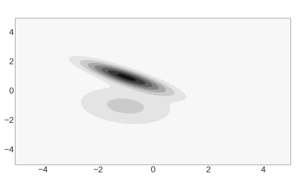
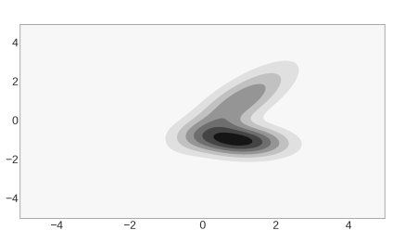
Neyman Pearson Lemma
DOI: 10.1098/rsta.1933.0009
Most powerful test to distinguish signal and background

Slide 7
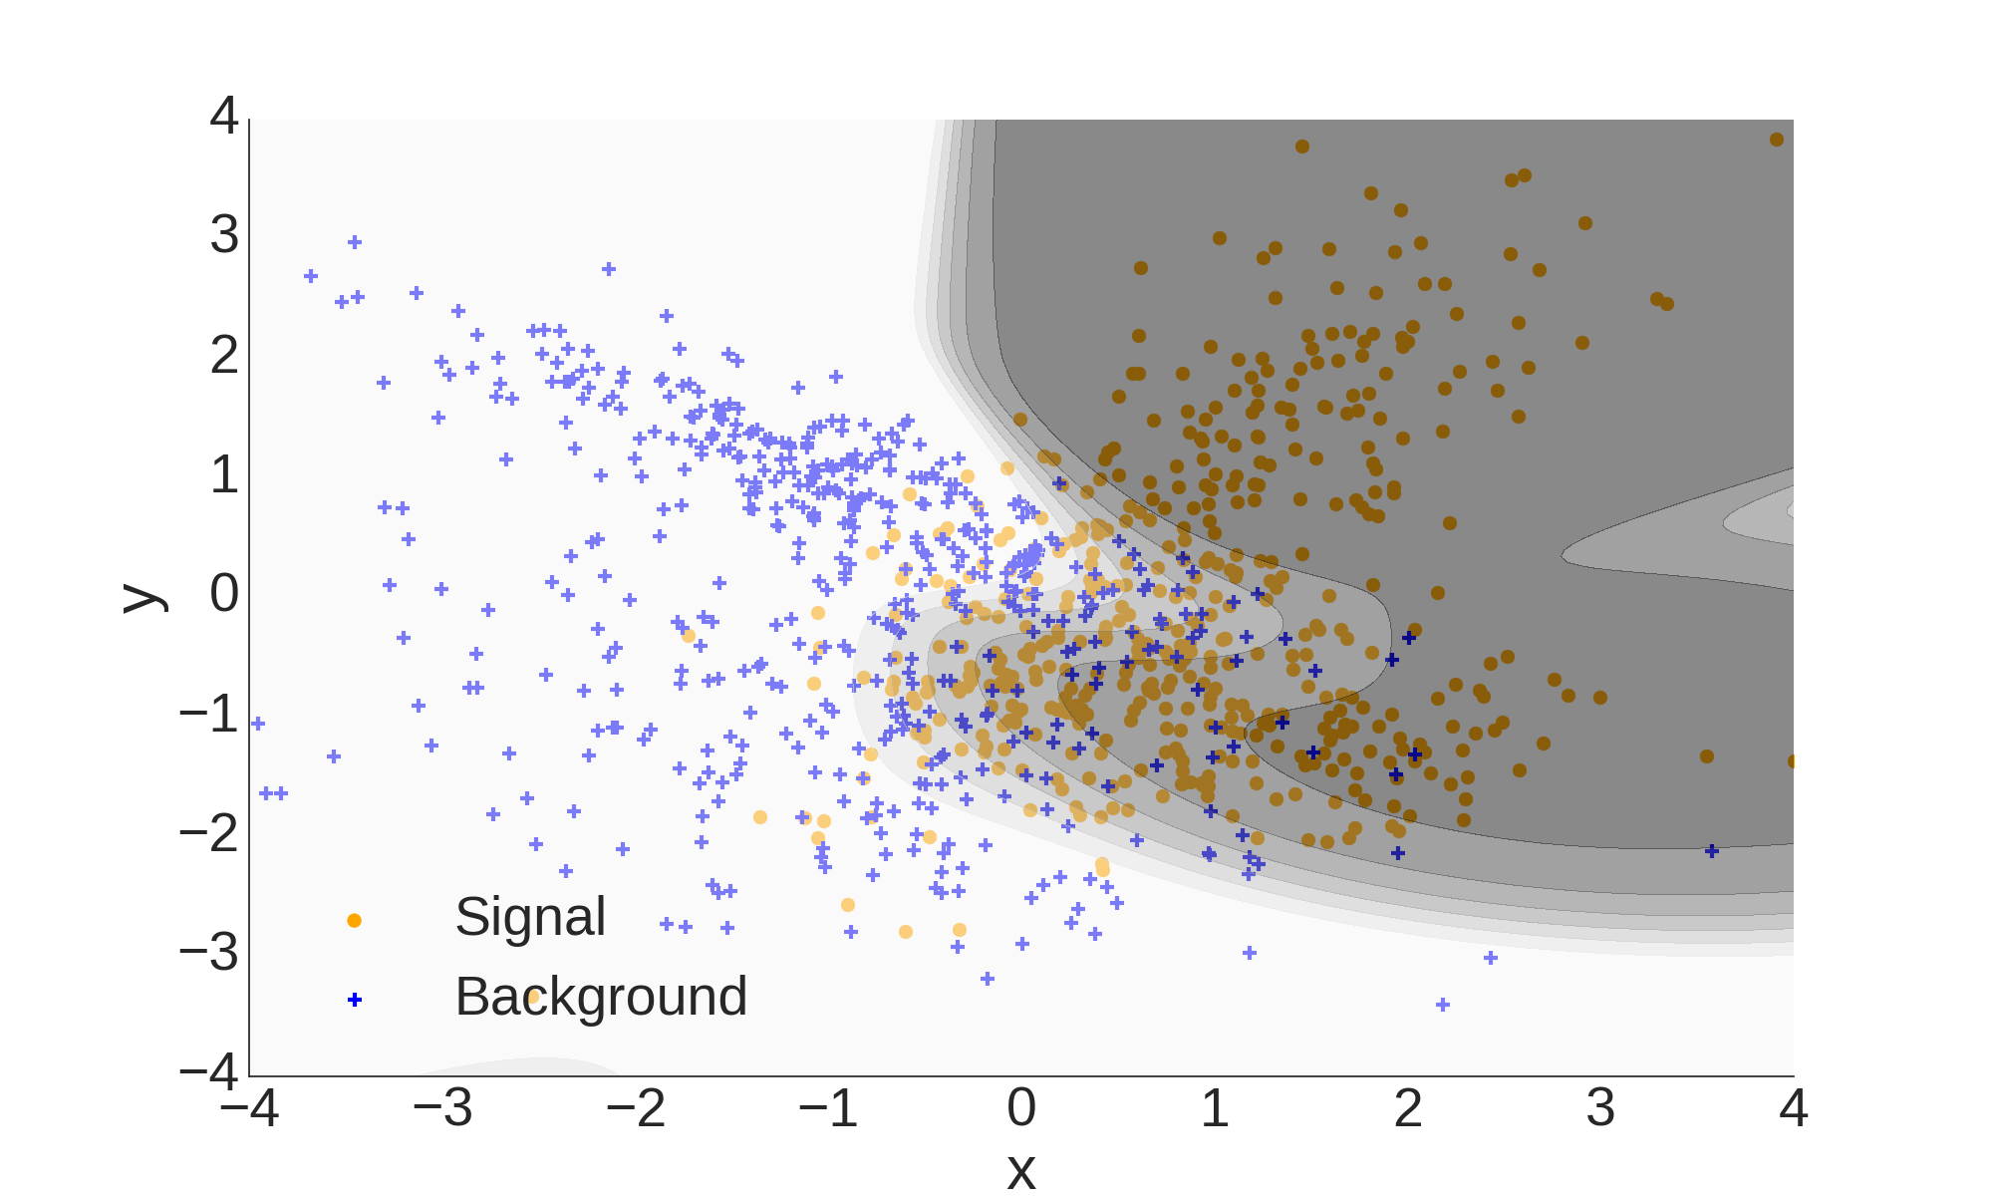
Contour Plot of NP-Classifier

Slide 8
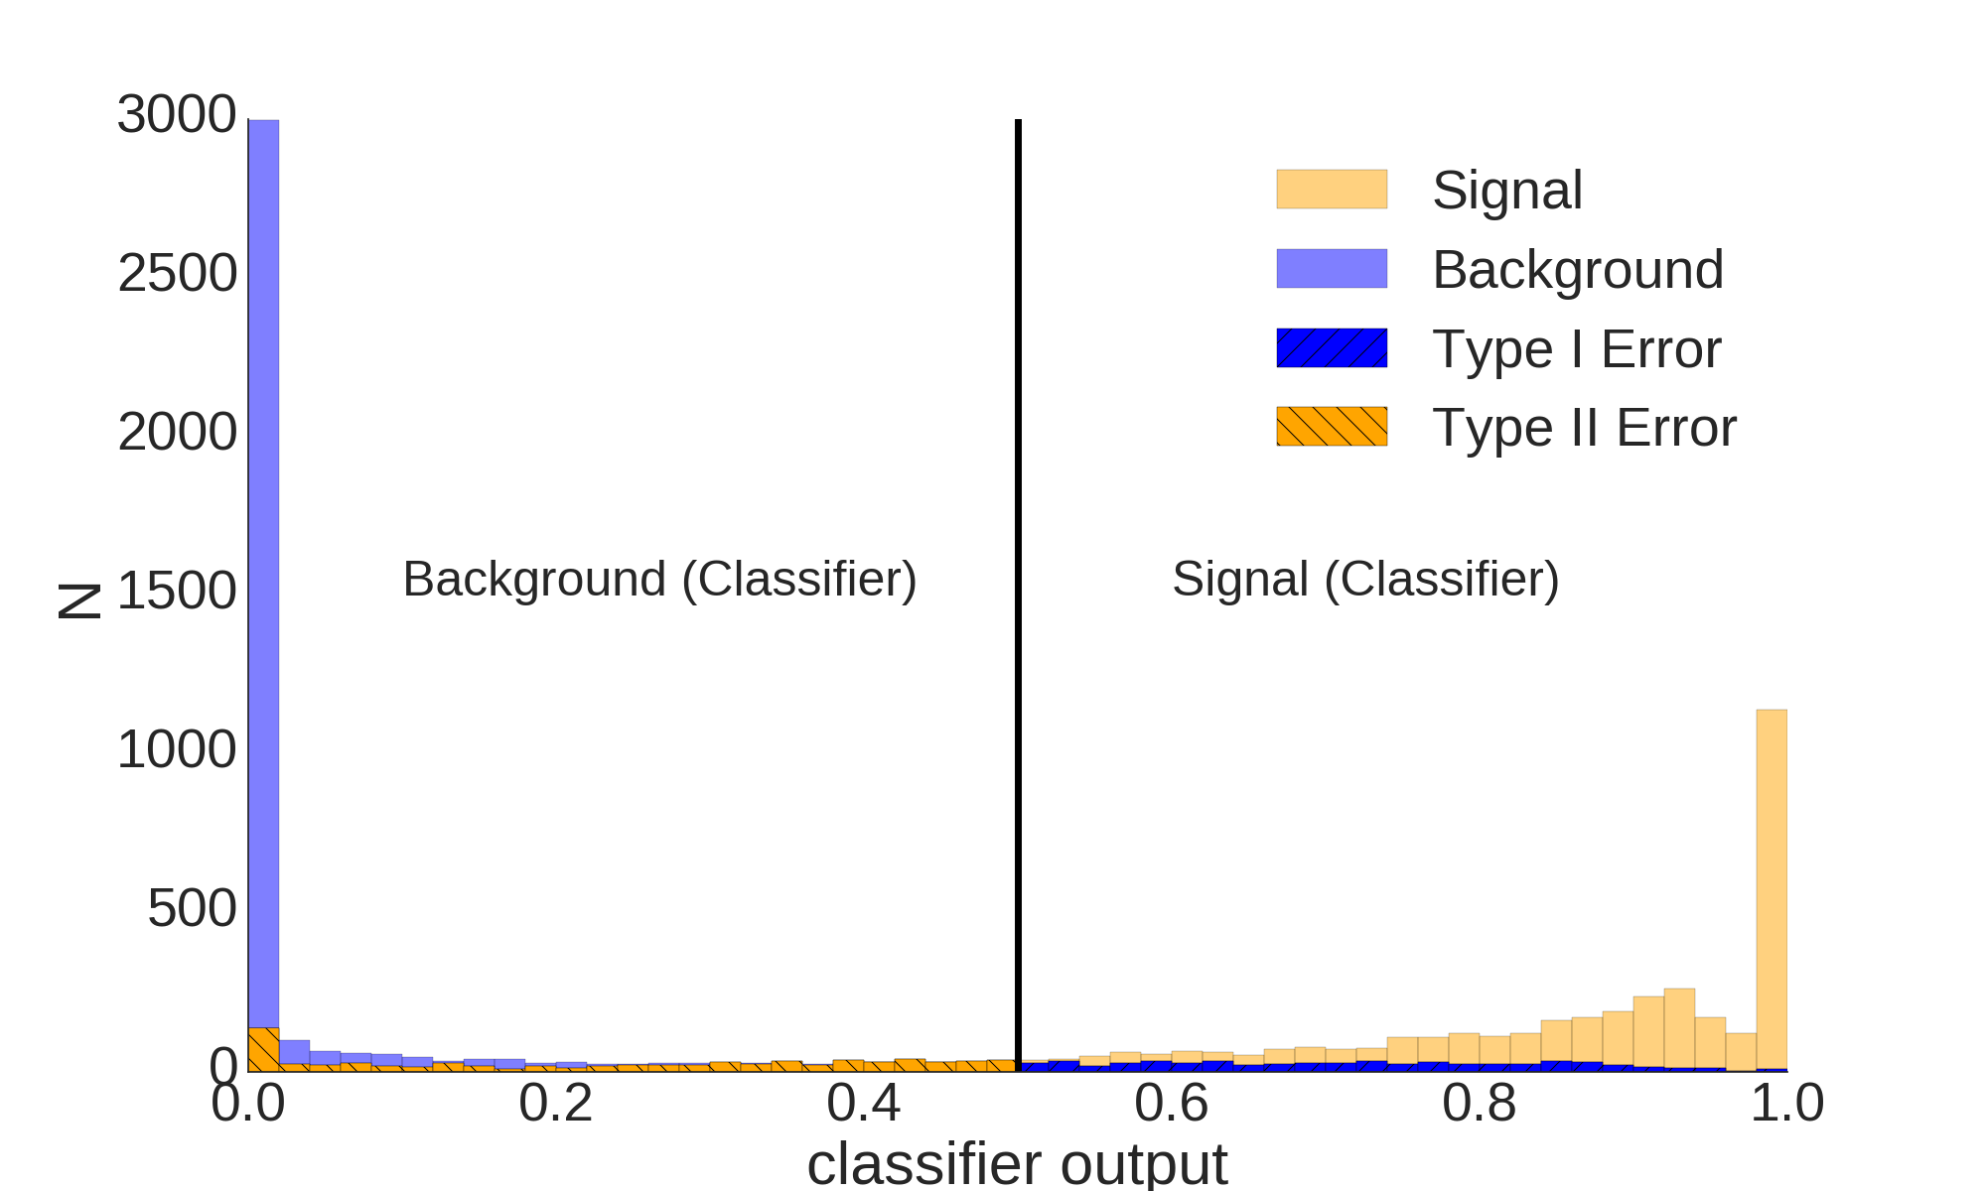
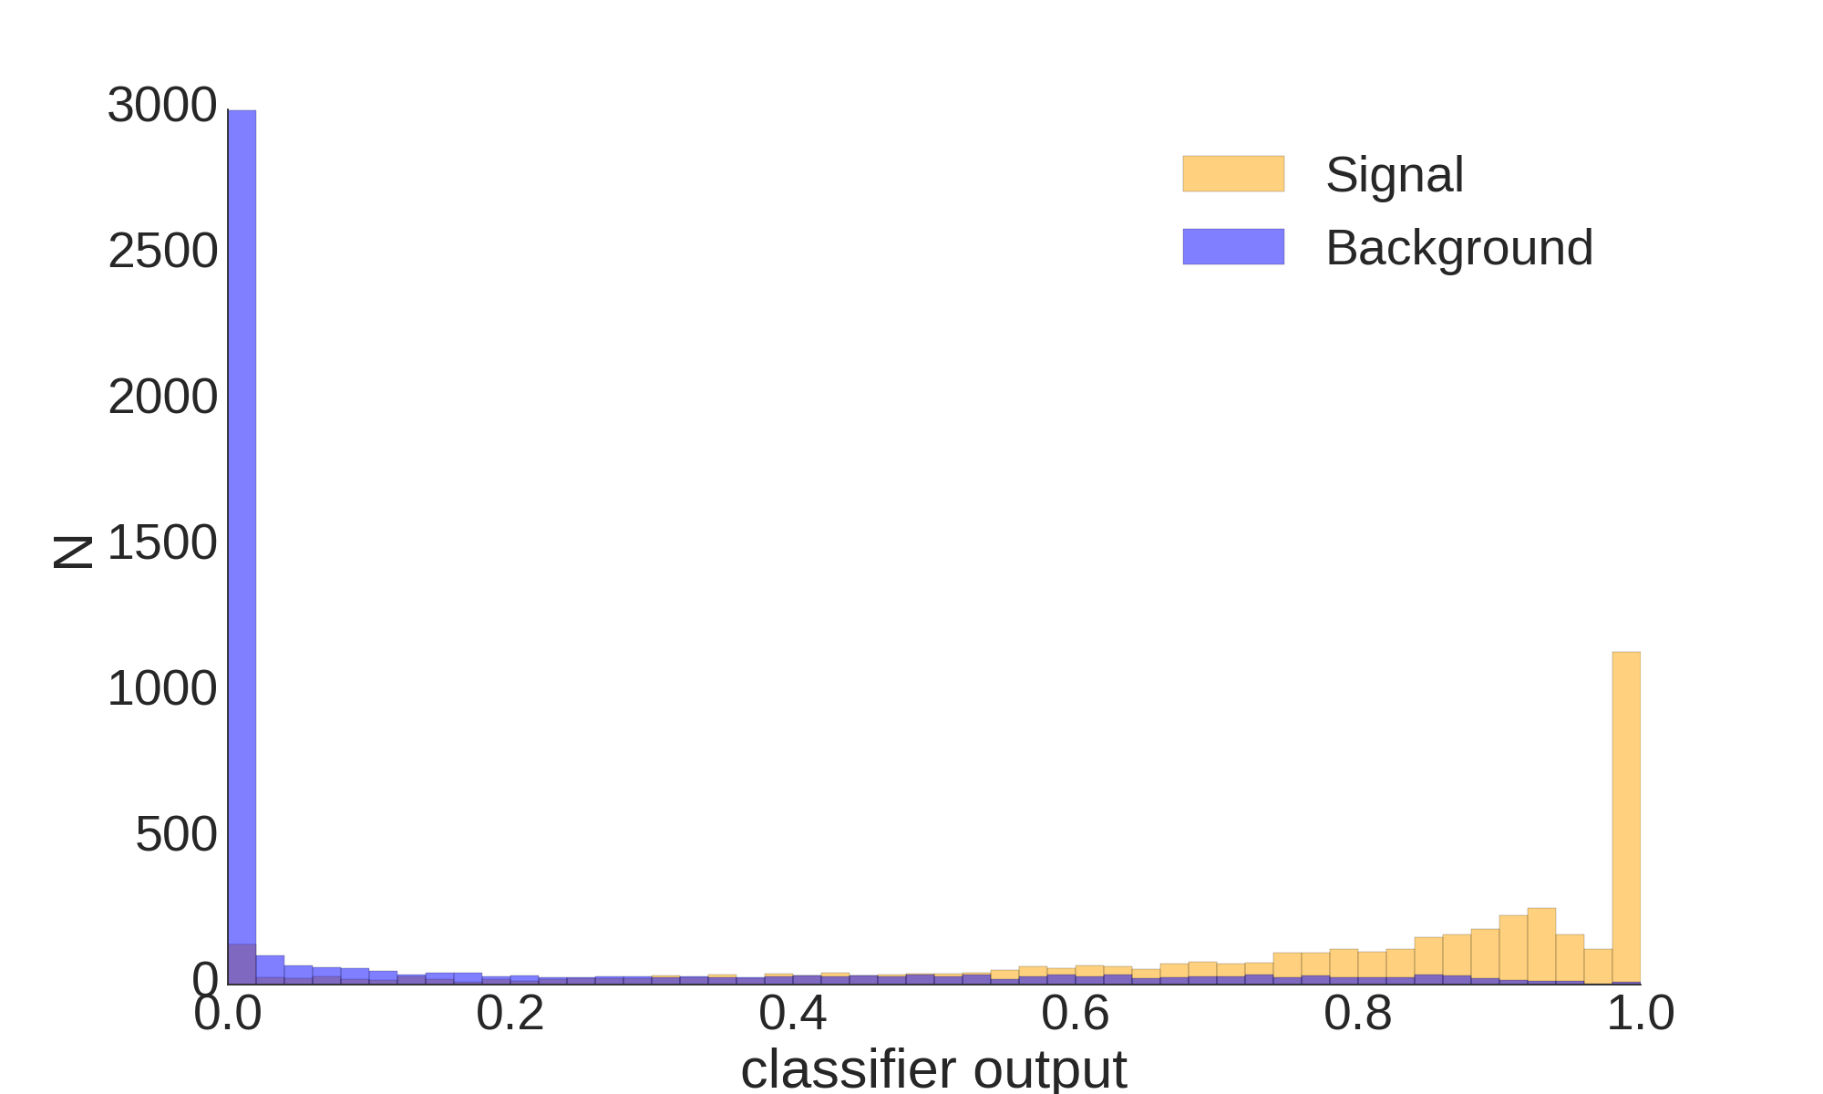
Classification Quality

Slide 9
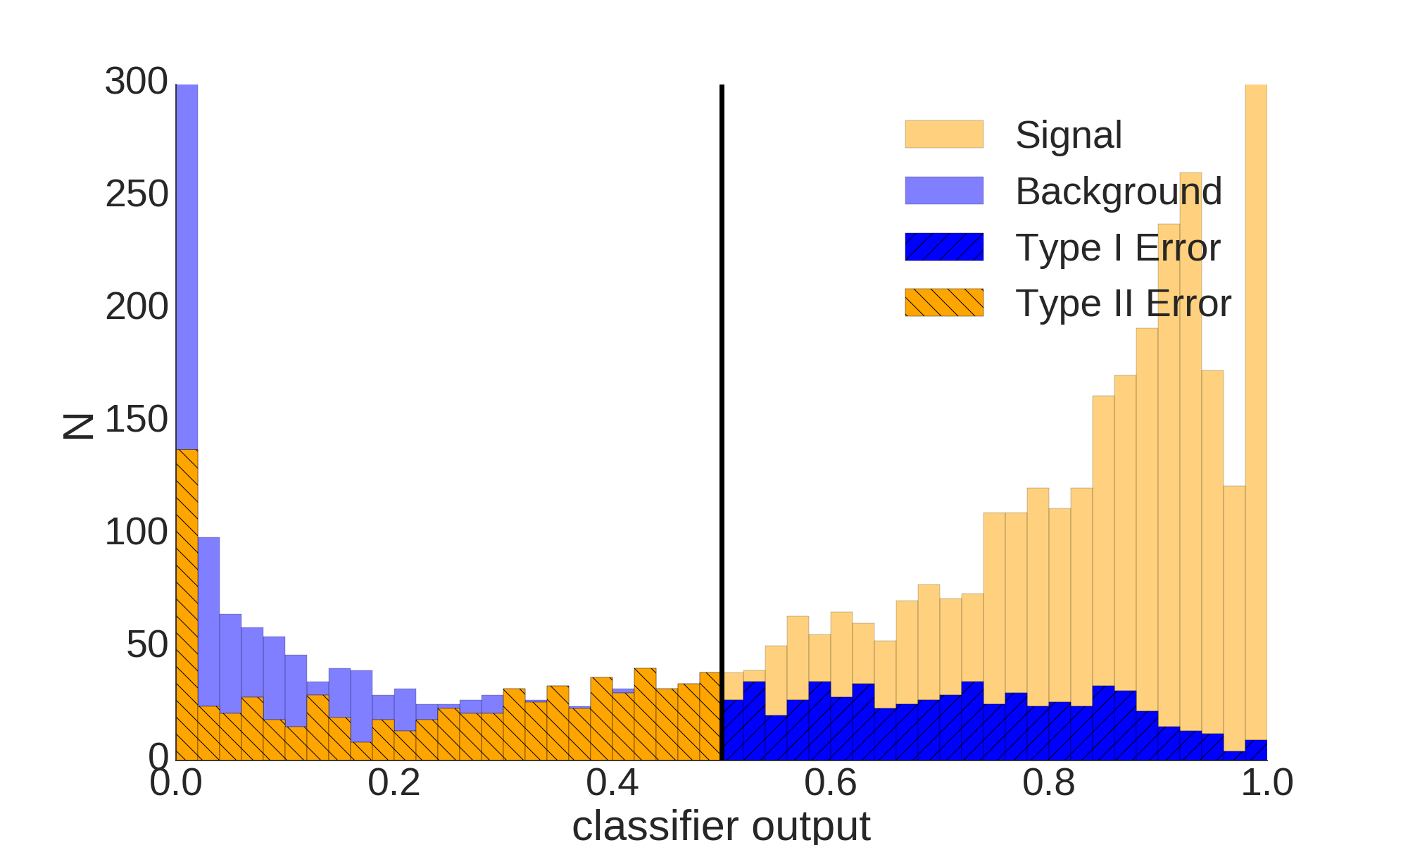
Classification Quality

Slide 10
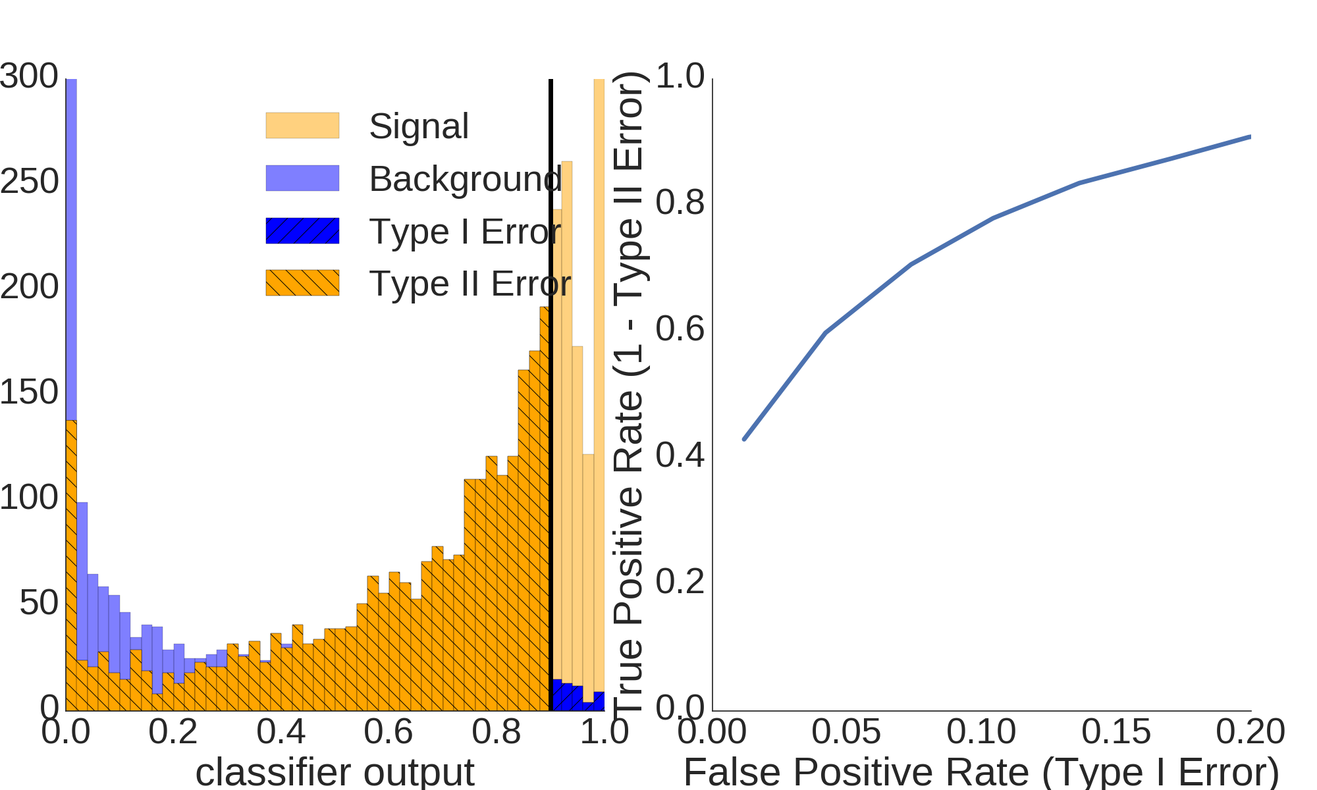
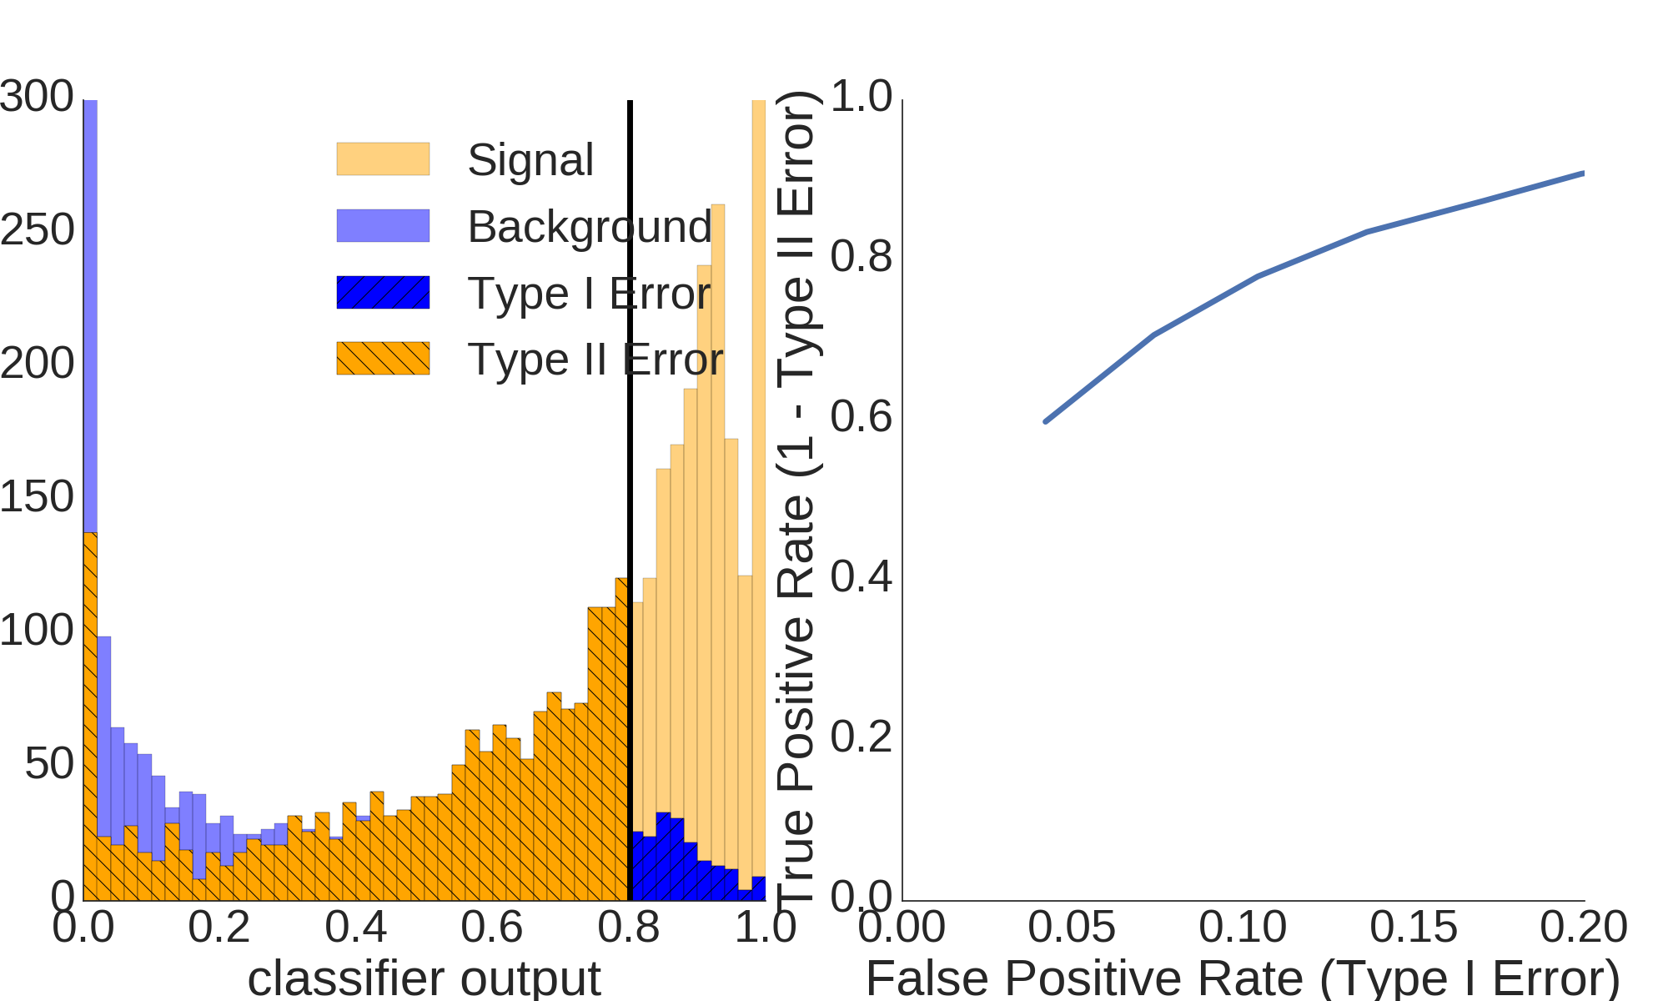
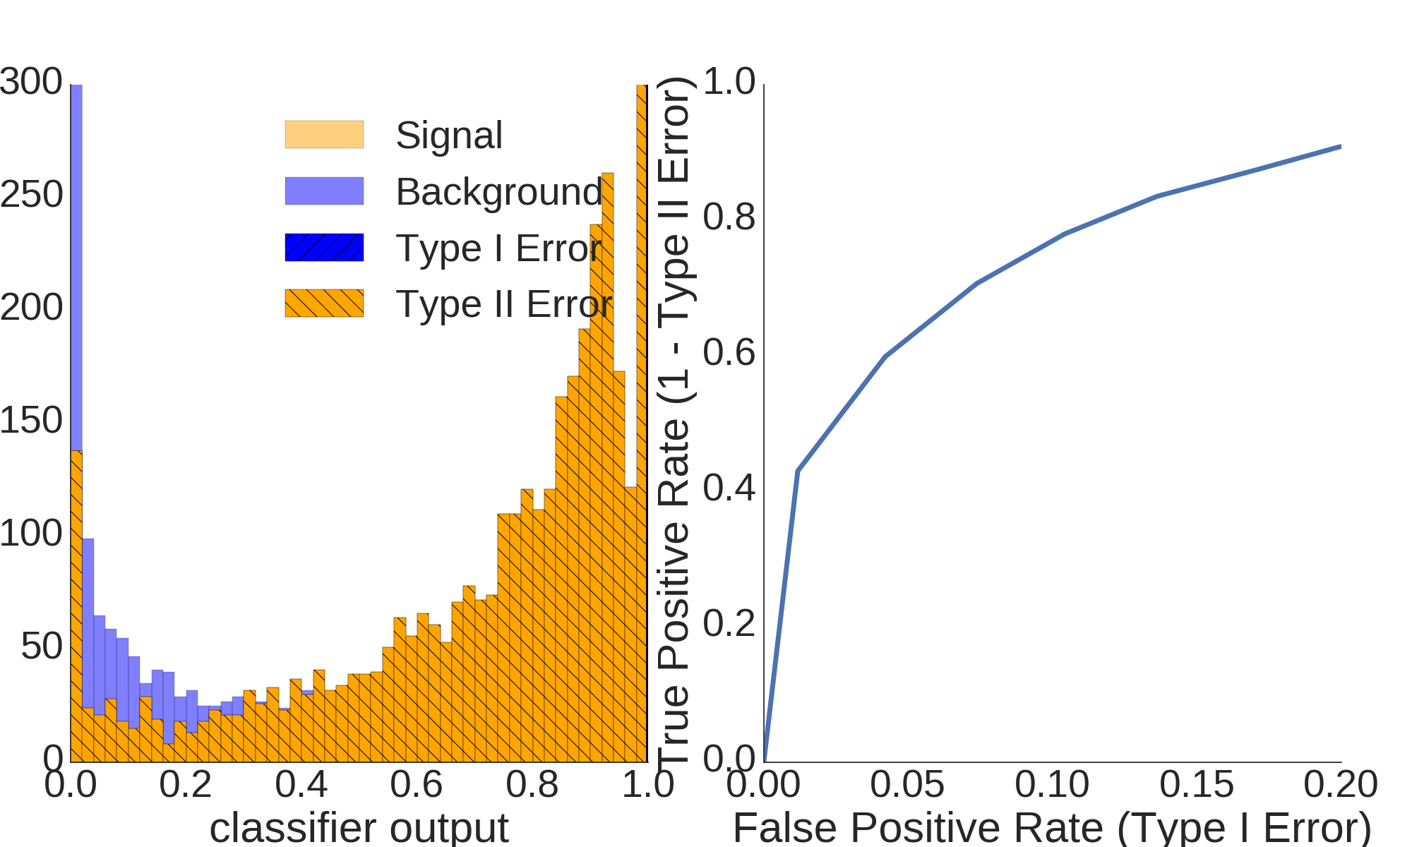
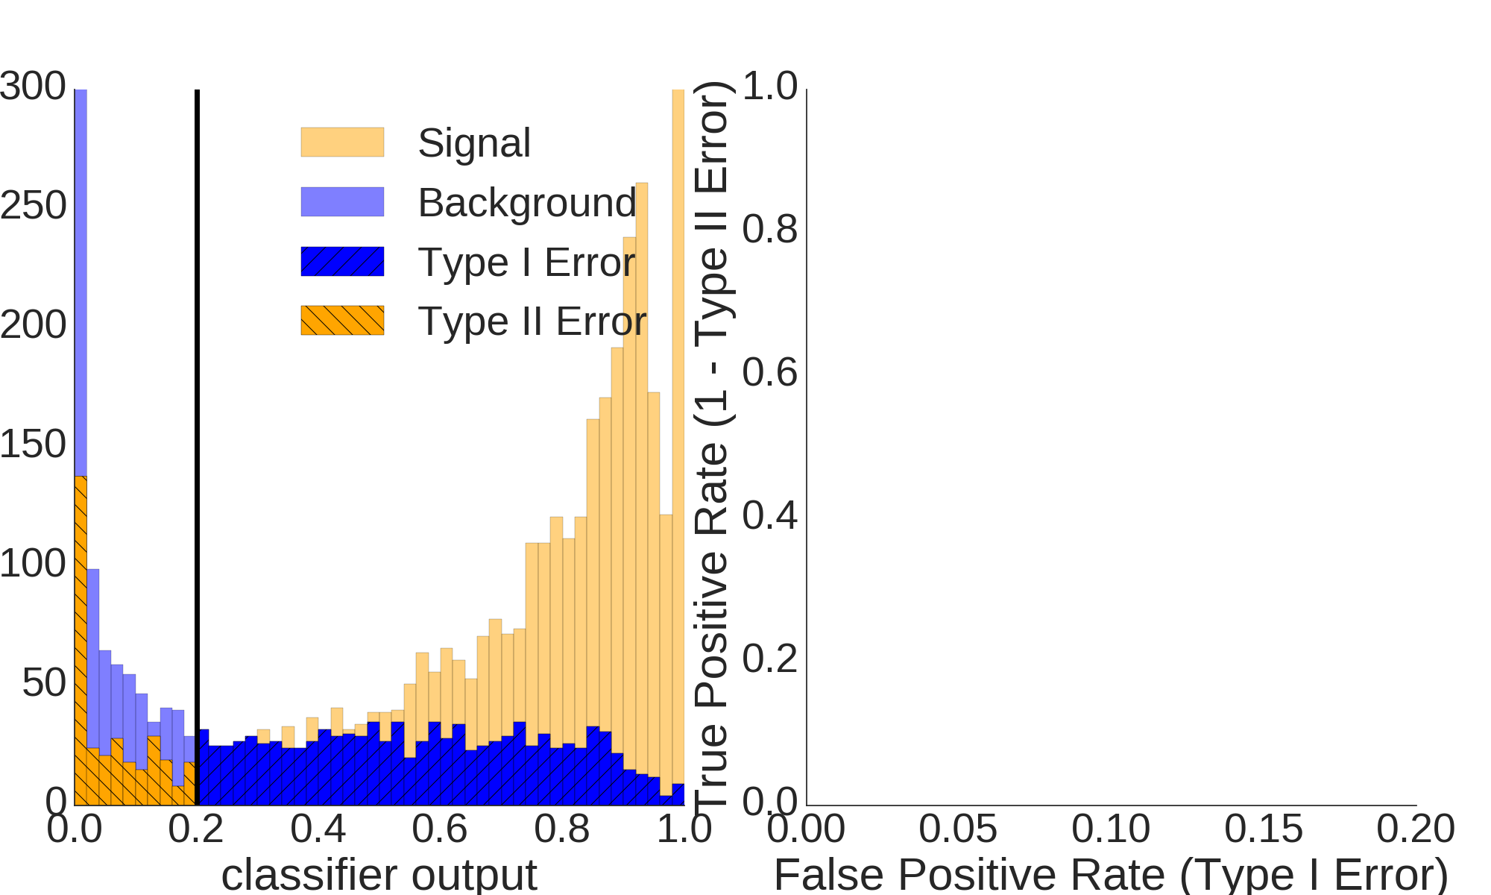
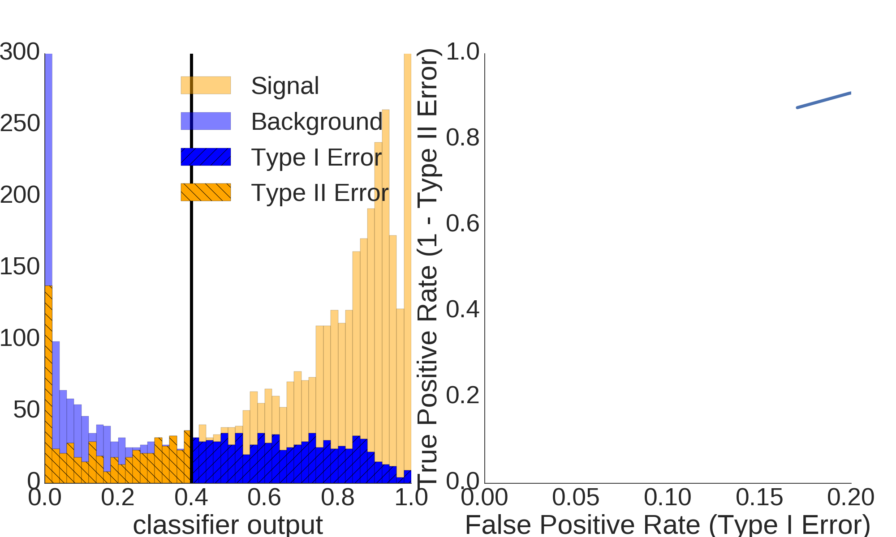

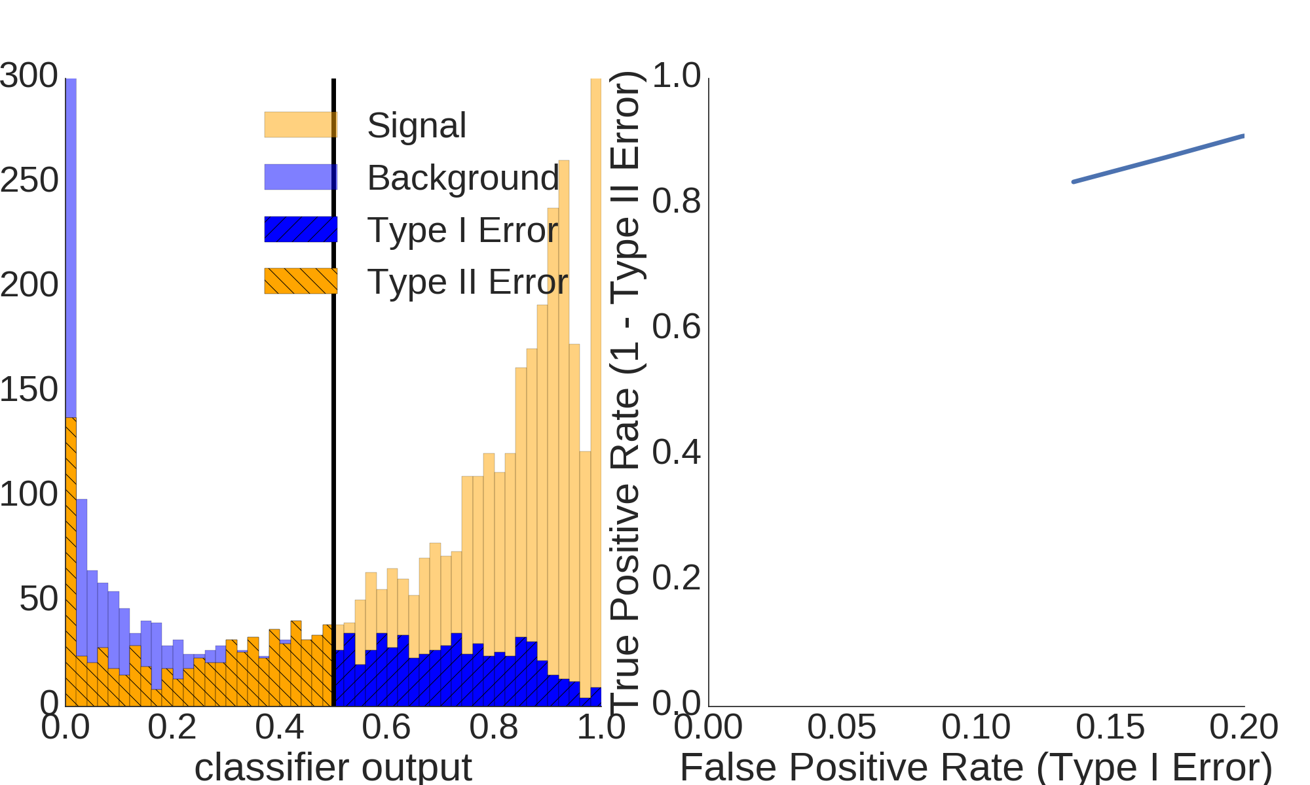

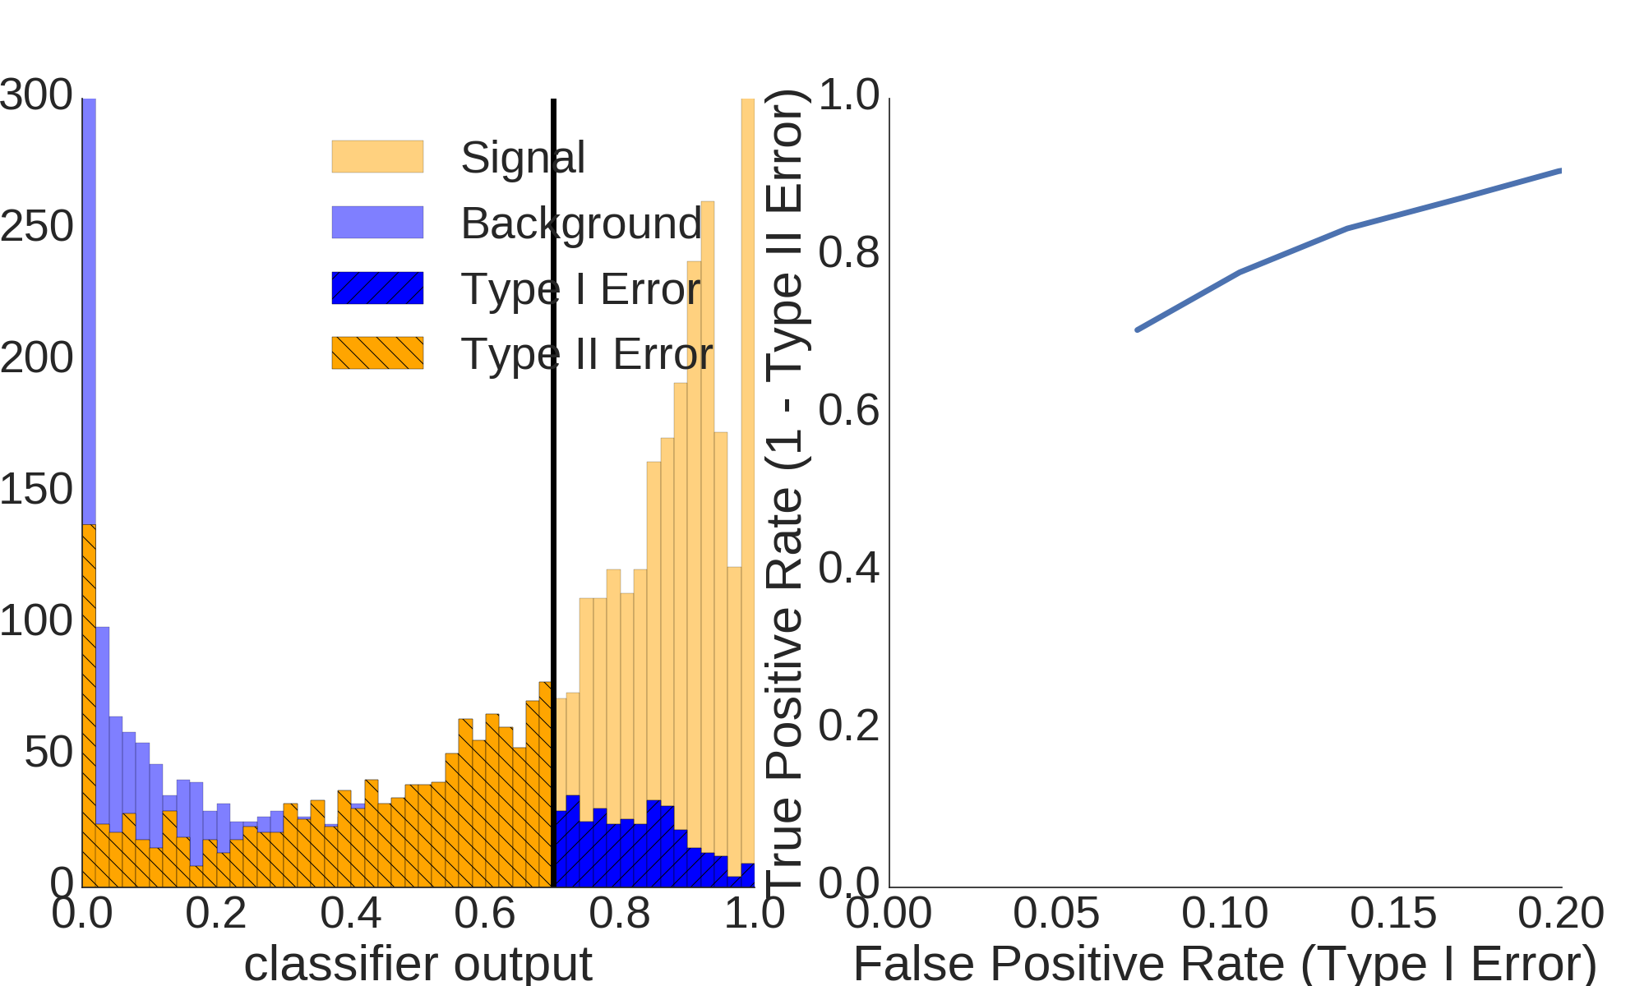
Receiver Operating Characteristic

Slide 11
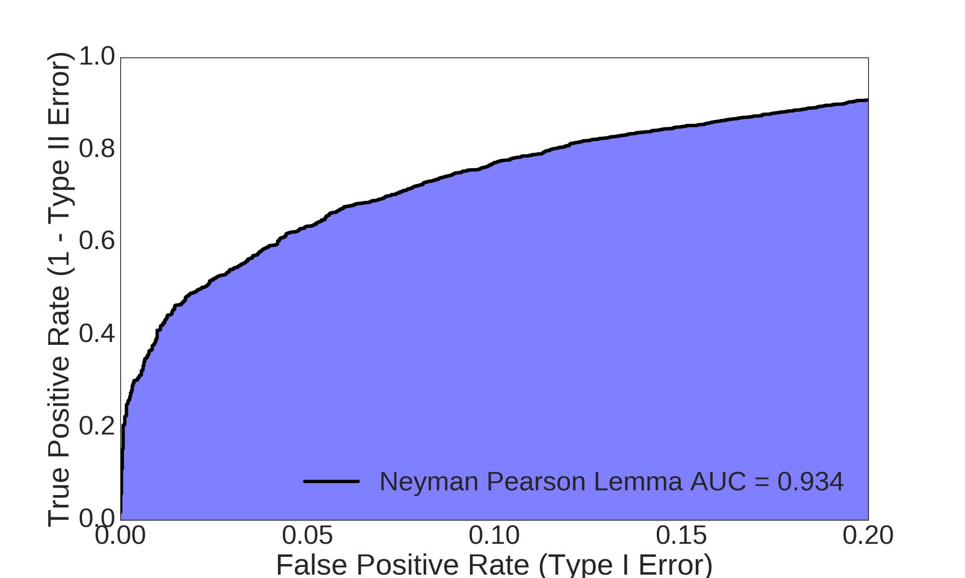
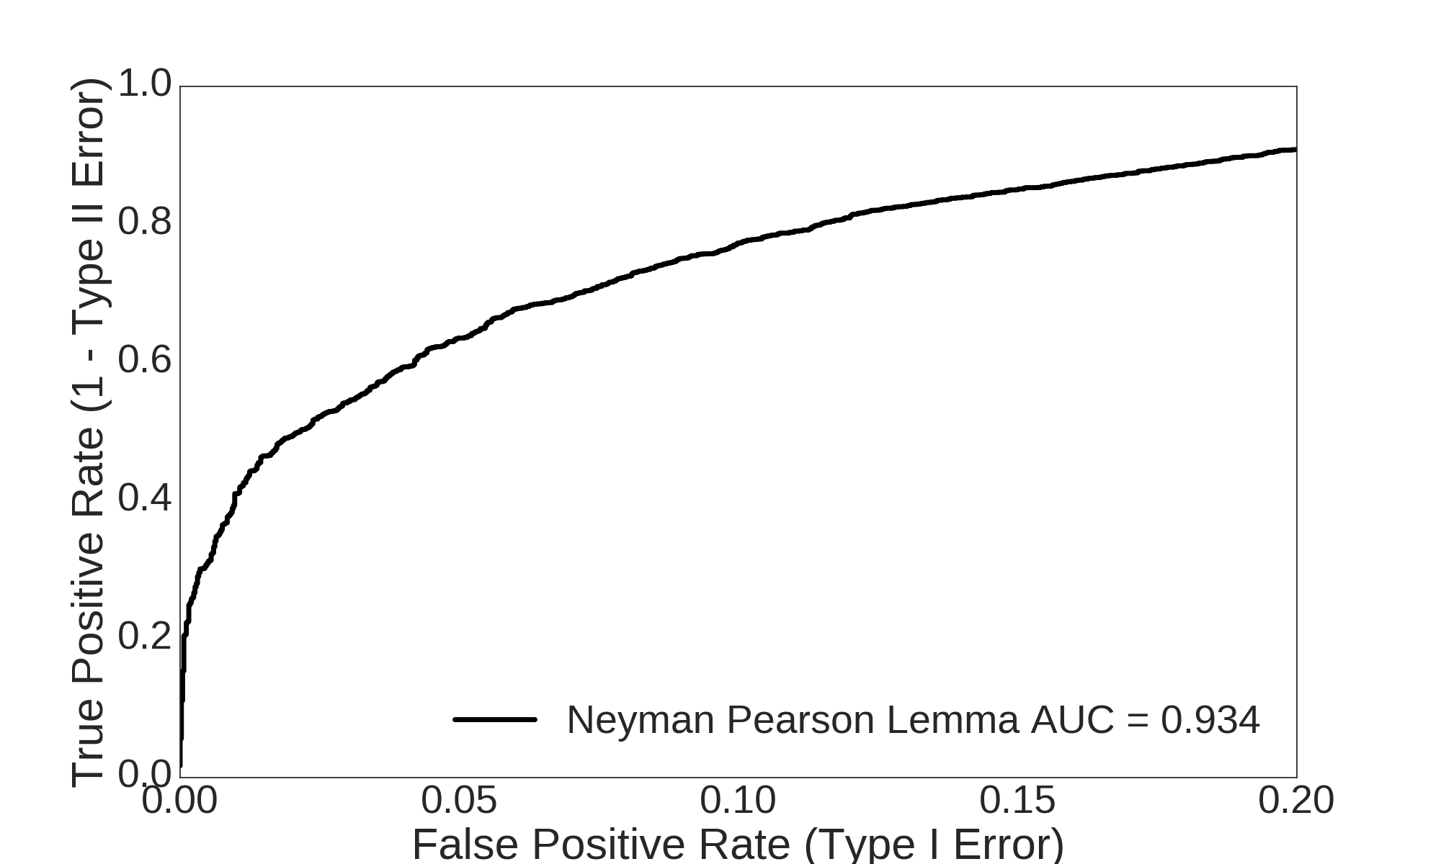
Receiver Operating Characteristic
Allowed region for an arbitrary classifier

Slide 12
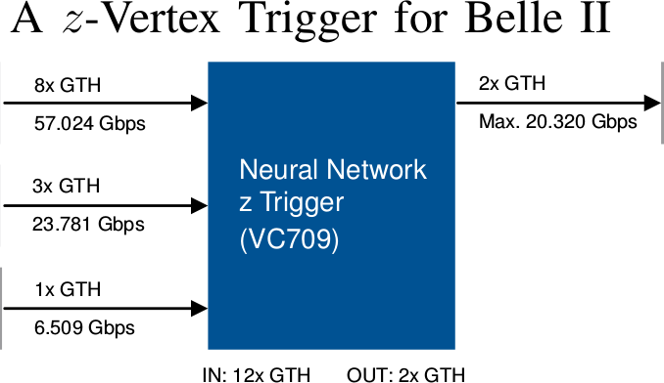
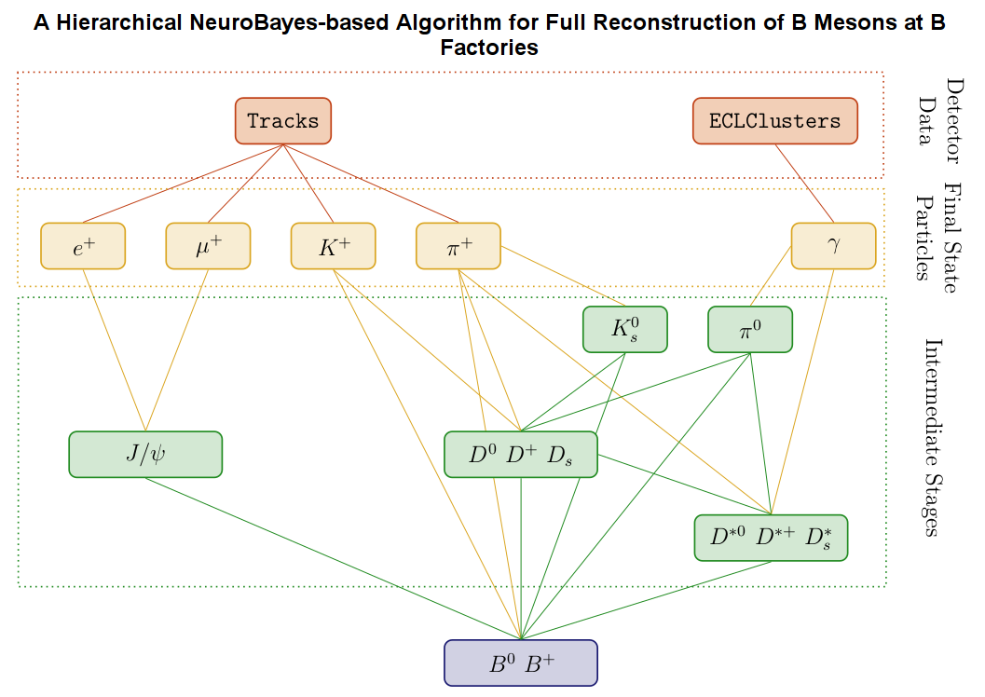
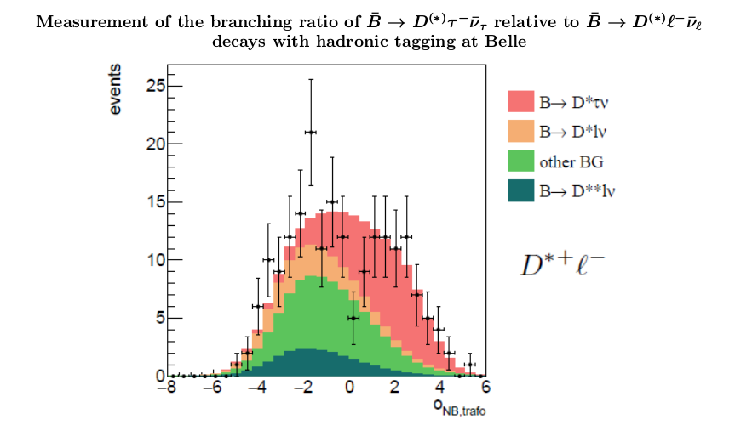
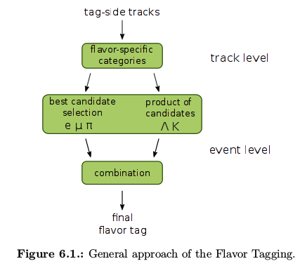
Multivariate Classification in HEP
Notes:
http://blog.kaggle.com/wp-content/uploads/2015/04/iris_petal_sepal.png
http://mirlab.org/jang/books/dcpr/dataSetIris.asp?title=2-2%20Iris%20Dataset

Slide 13
Multivariate Classification in HEP
Signal and Background PDF is unknown
Multiple sources for signal and background
Non Gaussian
Nonlinear dependencies among features
Medium number of dimensions/features D ≈ O(100)
Curse of dimensionality → PDFs cannot be sampled
High number of samples/events N ≈ O(1 000 000)
Training and Application time matters
Often simulated data (→ systematics)
Notes:
http://blog.kaggle.com/wp-content/uploads/2015/04/iris_petal_sepal.png
http://mirlab.org/jang/books/dcpr/dataSetIris.asp?title=2-2%20Iris%20Dataset

Slide 14
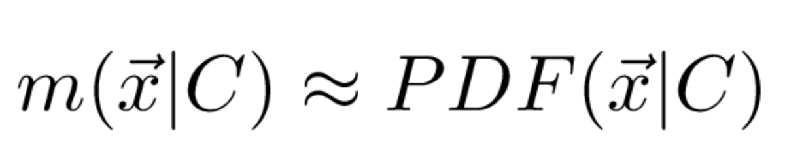
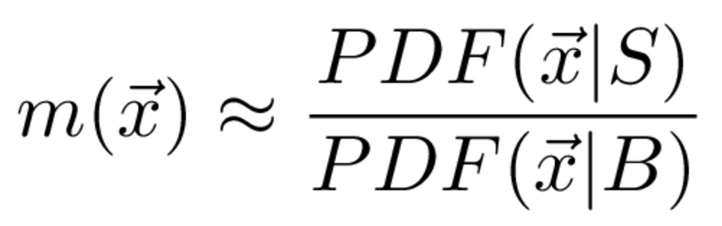
Classifier Models
Neyman Pearson Lemma
Generative Models
Restricted Boltzmann machine
Kernel density estimator
Gaussian mixture model
Discriminative Models
Linear discriminant analysis
Quadratic discriminant analysis
(Boosted) Decision Trees
Support Vector machine
Artificial neural networks

Slide 15
Discriminant Analysis / Analytical methods

Slide 16
Discriminant Analysis
Analytical / closed-form solutions of Neyman-Pearson Lemma
Linear discriminant analysis (LDA)
Assumes conditional PDFs are normally distributed
Assumes identical covariances of signal and background
Equivalent to commonly used Fisher's discriminant
Requires only means and covariances of sample
Separating hyperplane is linear
Quadratic discriminant analysis (QDA)
Assumes conditional PDFs are normally distributed
Requires only means and covariances of sample
Separating hyperplane is quadratic
Notes:
http://blog.kaggle.com/wp-content/uploads/2015/04/iris_petal_sepal.png
http://mirlab.org/jang/books/dcpr/dataSetIris.asp?title=2-2%20Iris%20Dataset

Slide 17
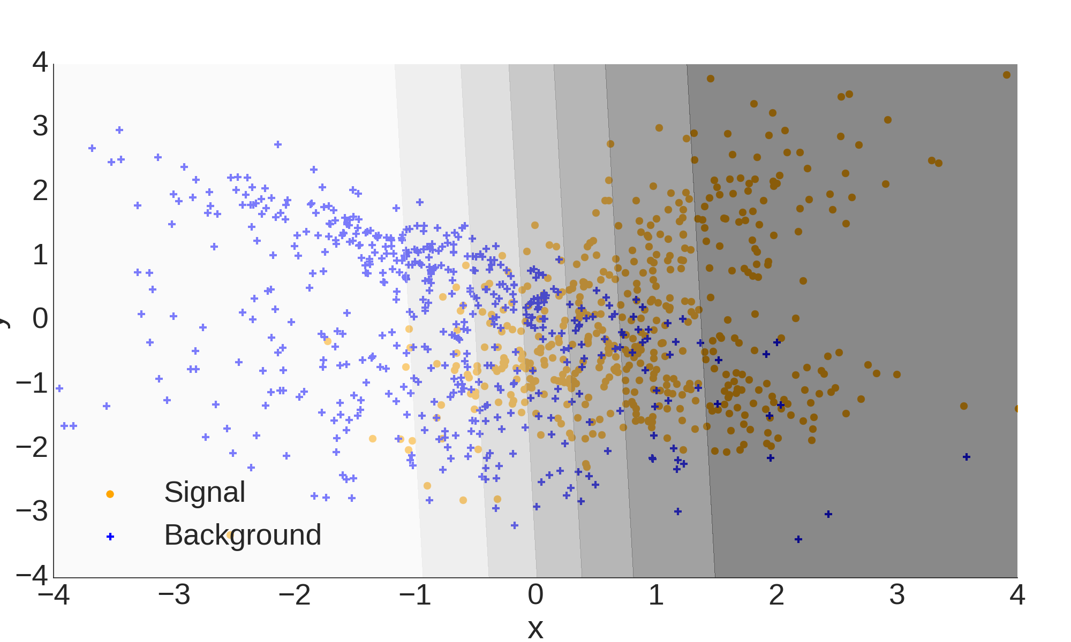
Linear Discriminant Analysis

Slide 18
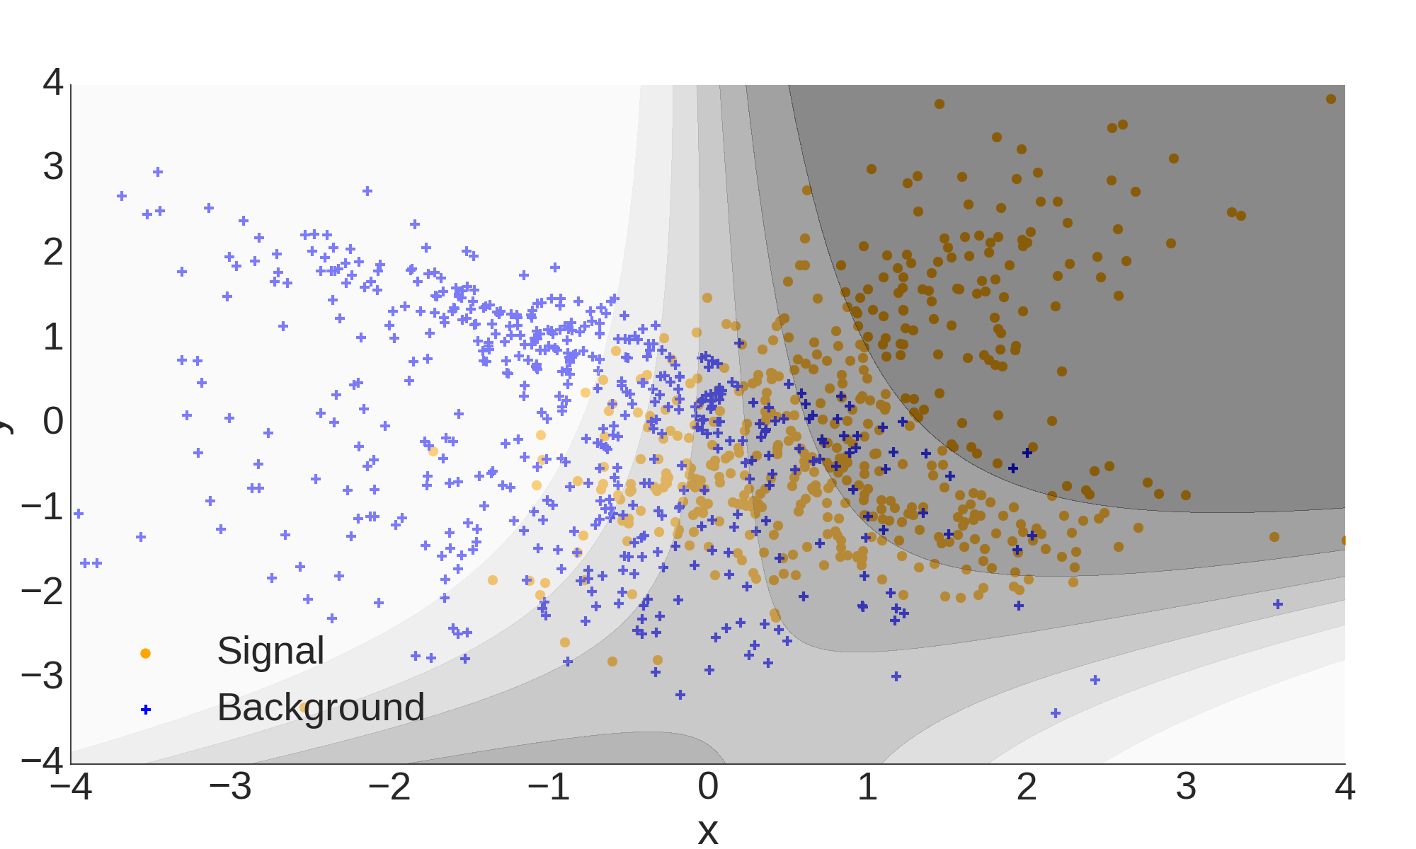
Quadratic Discriminant Analysis

Slide 19
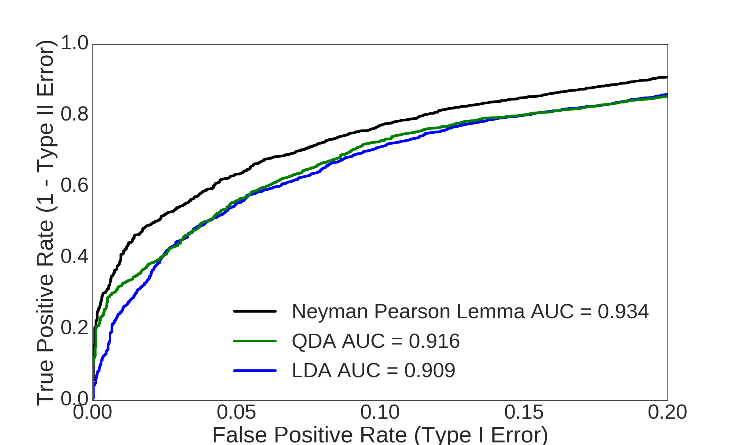
Discriminant Analysis

Slide 20
Decision Trees / Model complexity

Slide 21
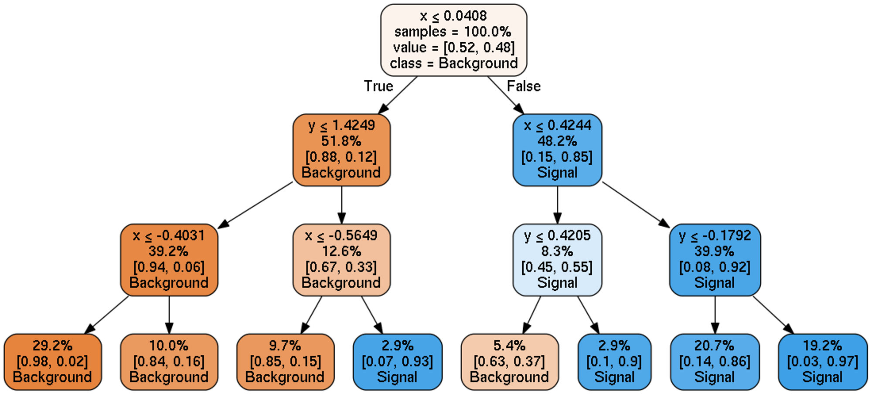
Simple Decision Tree

Slide 22
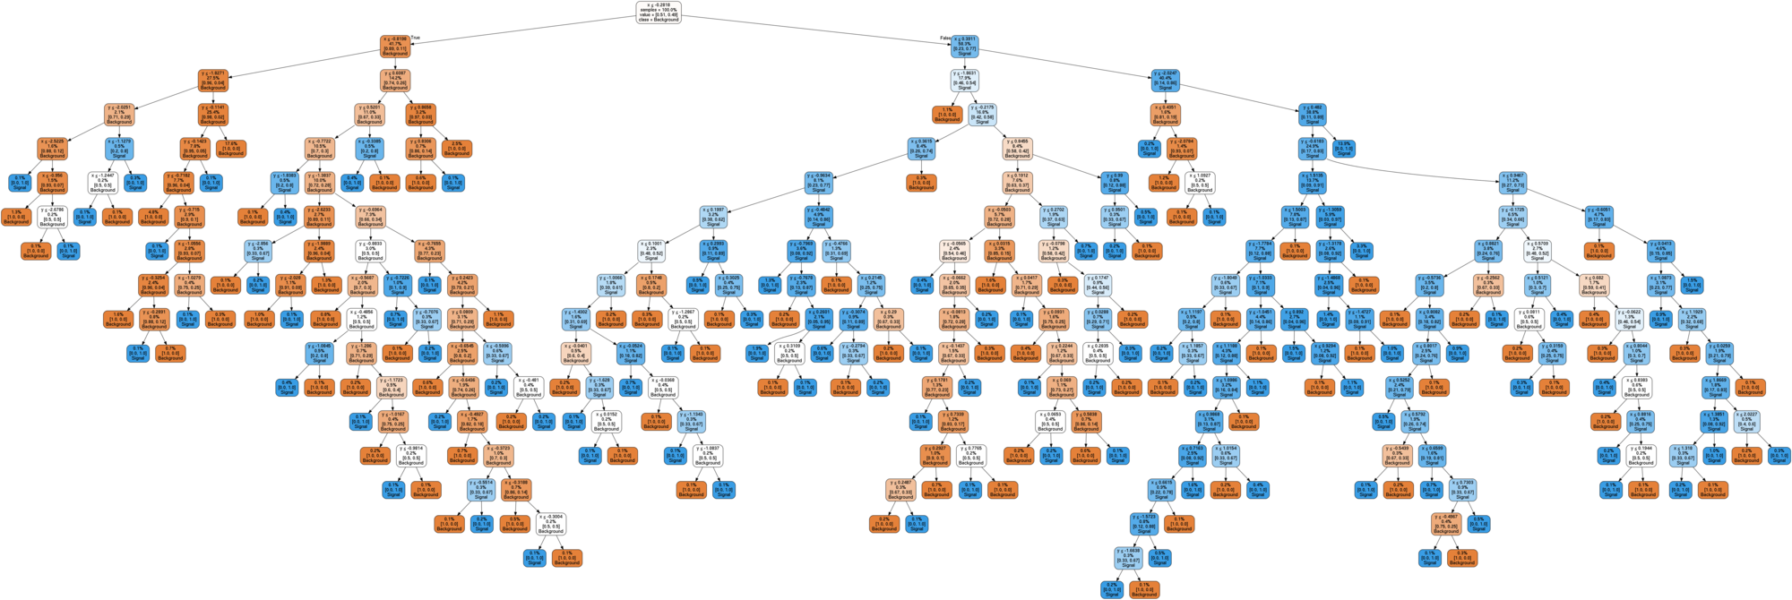
Complete Decision Tree
Complete tree with pure leaves → Complex model

Slide 23
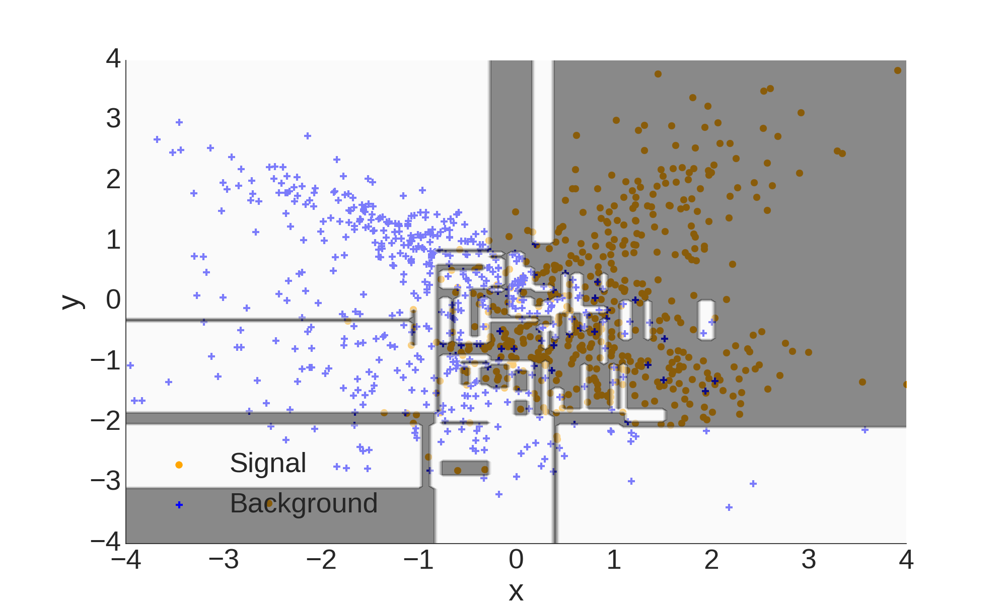
Decision Tree

Slide 24
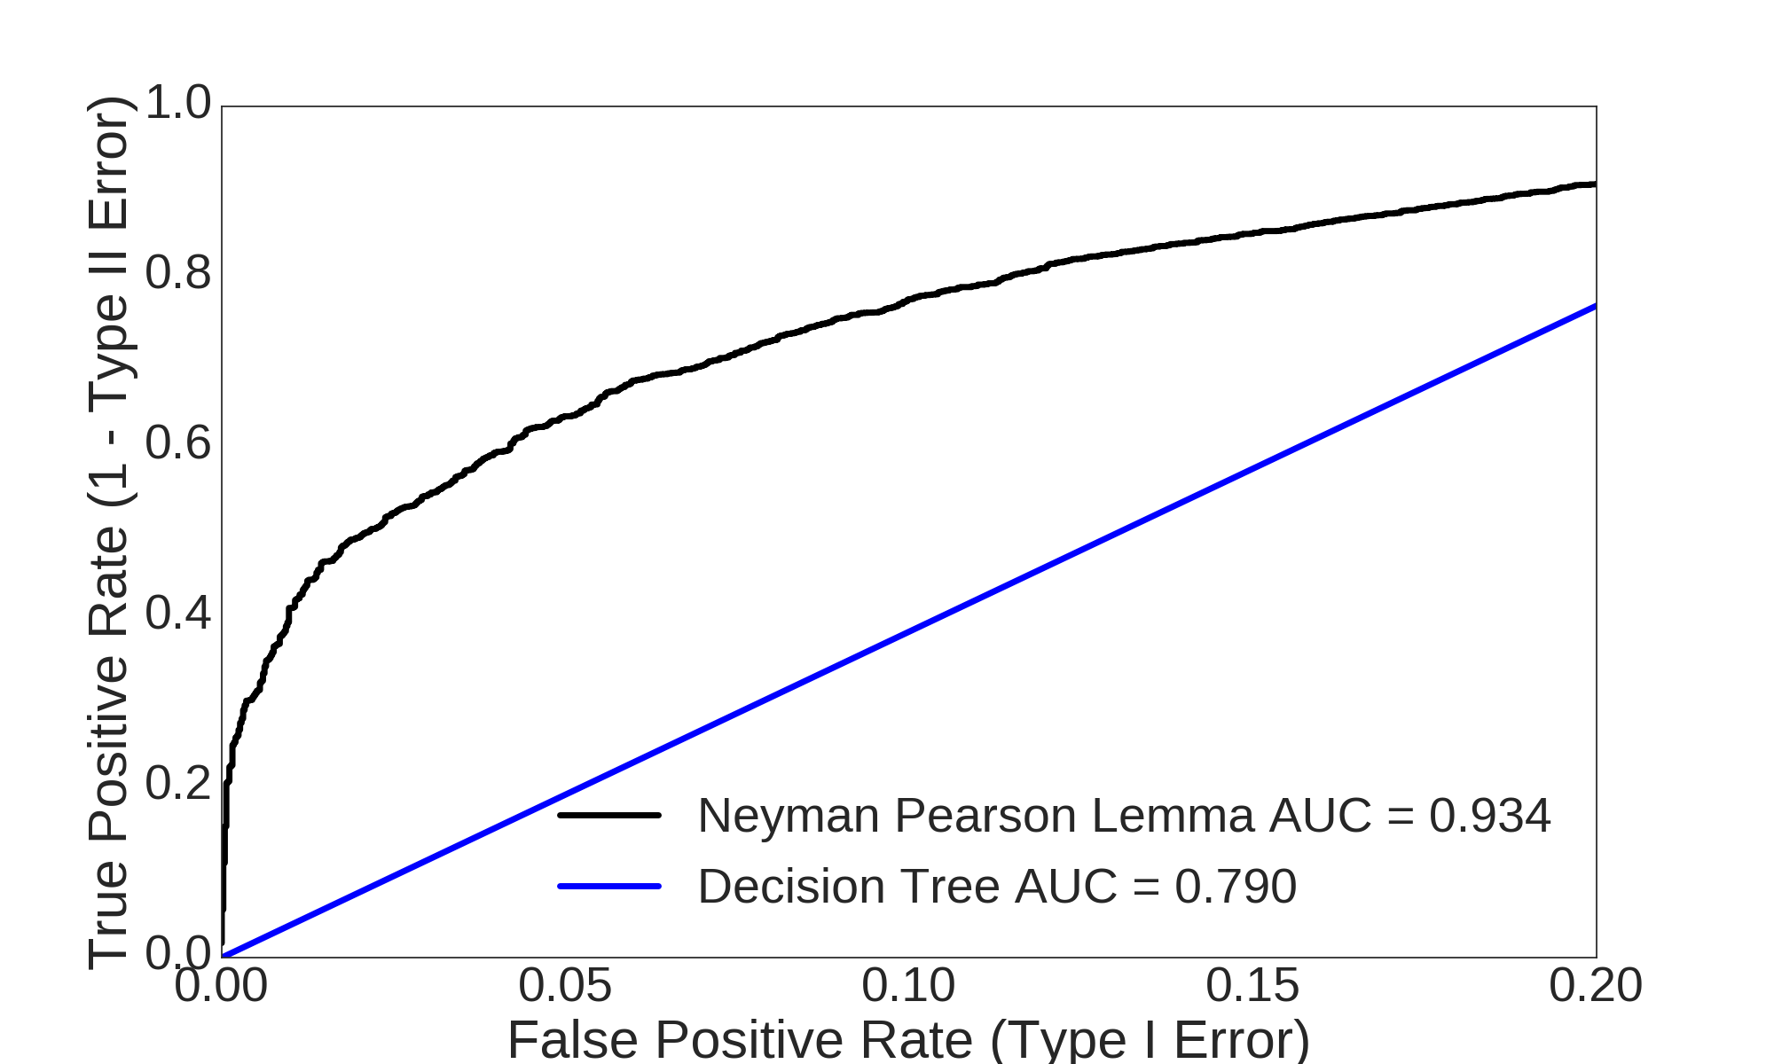
Decision Tree
Complex model performs poorly

Slide 25
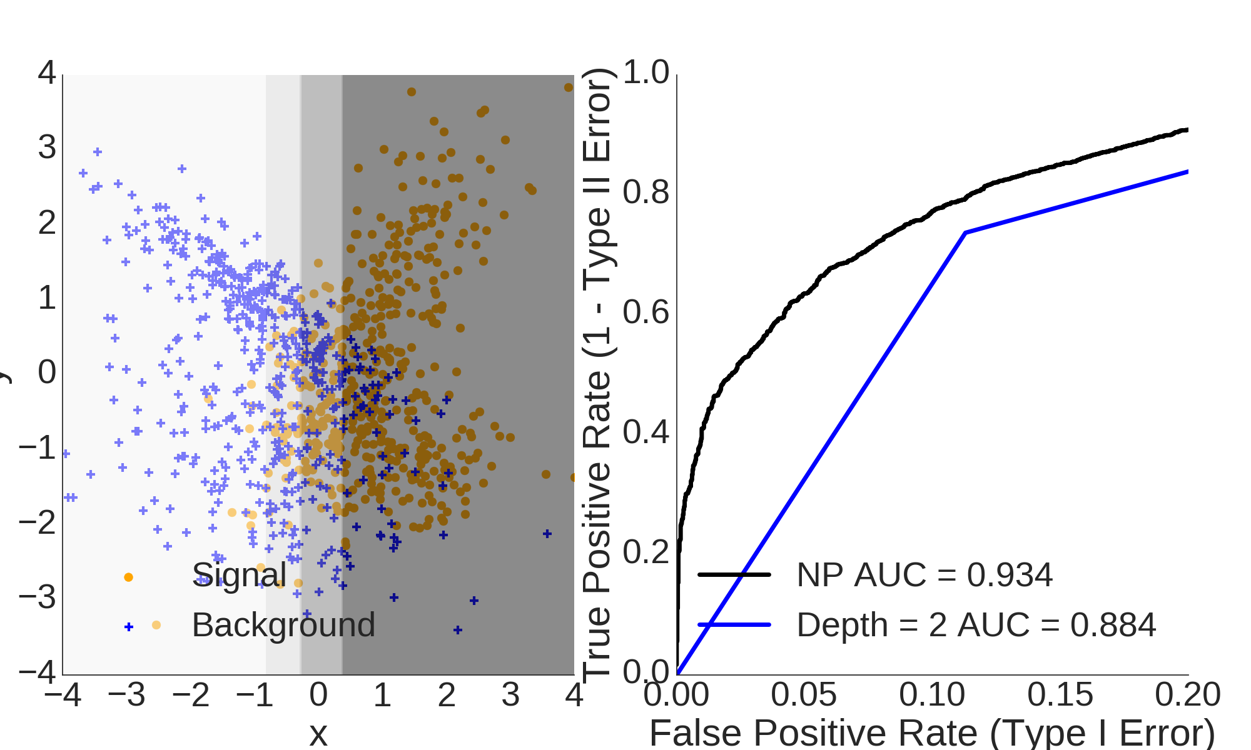
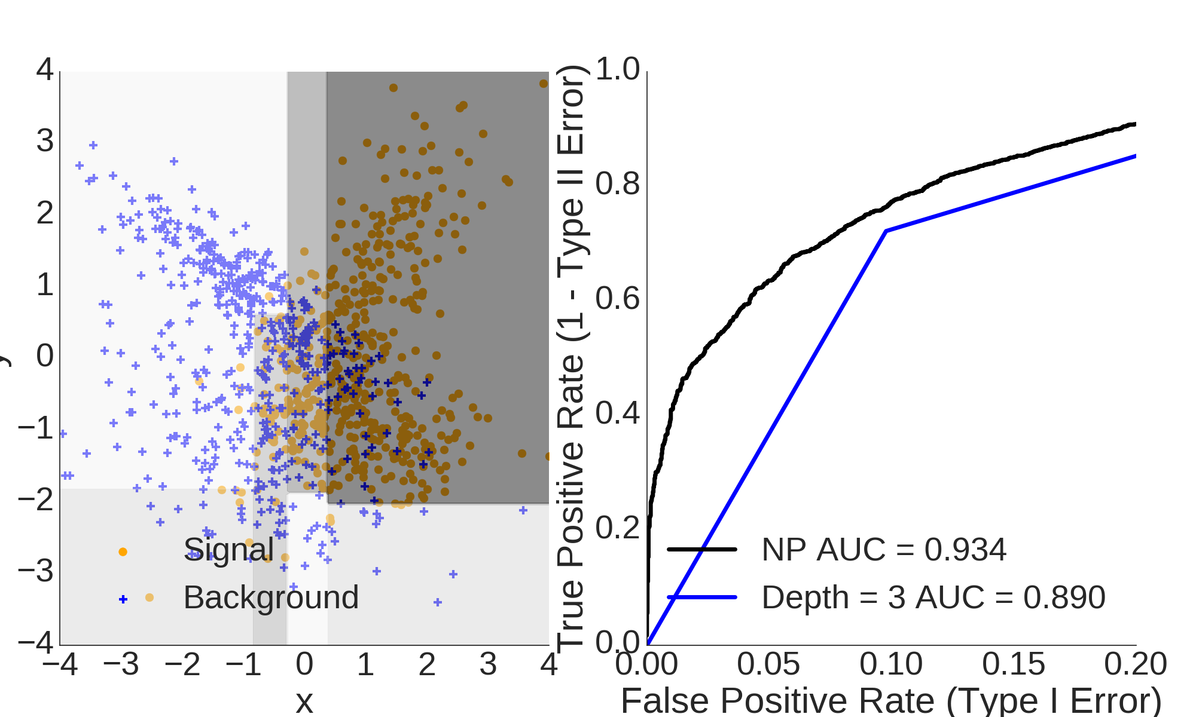
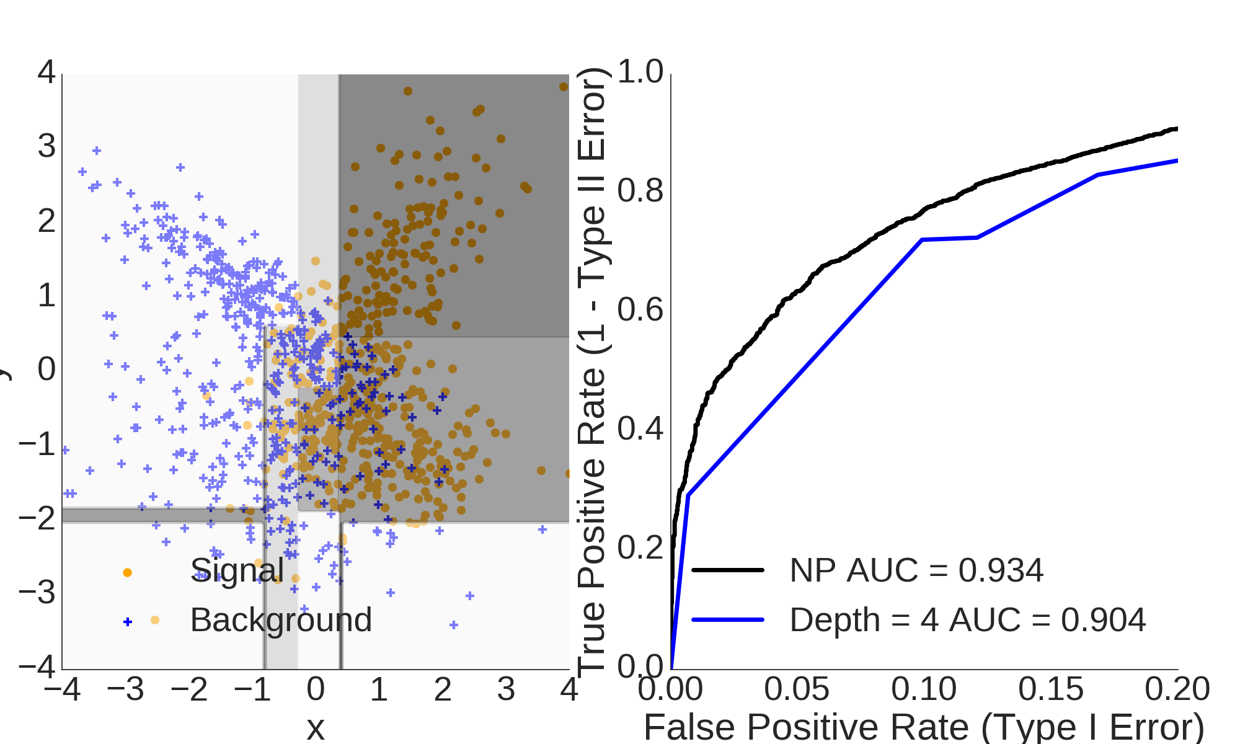
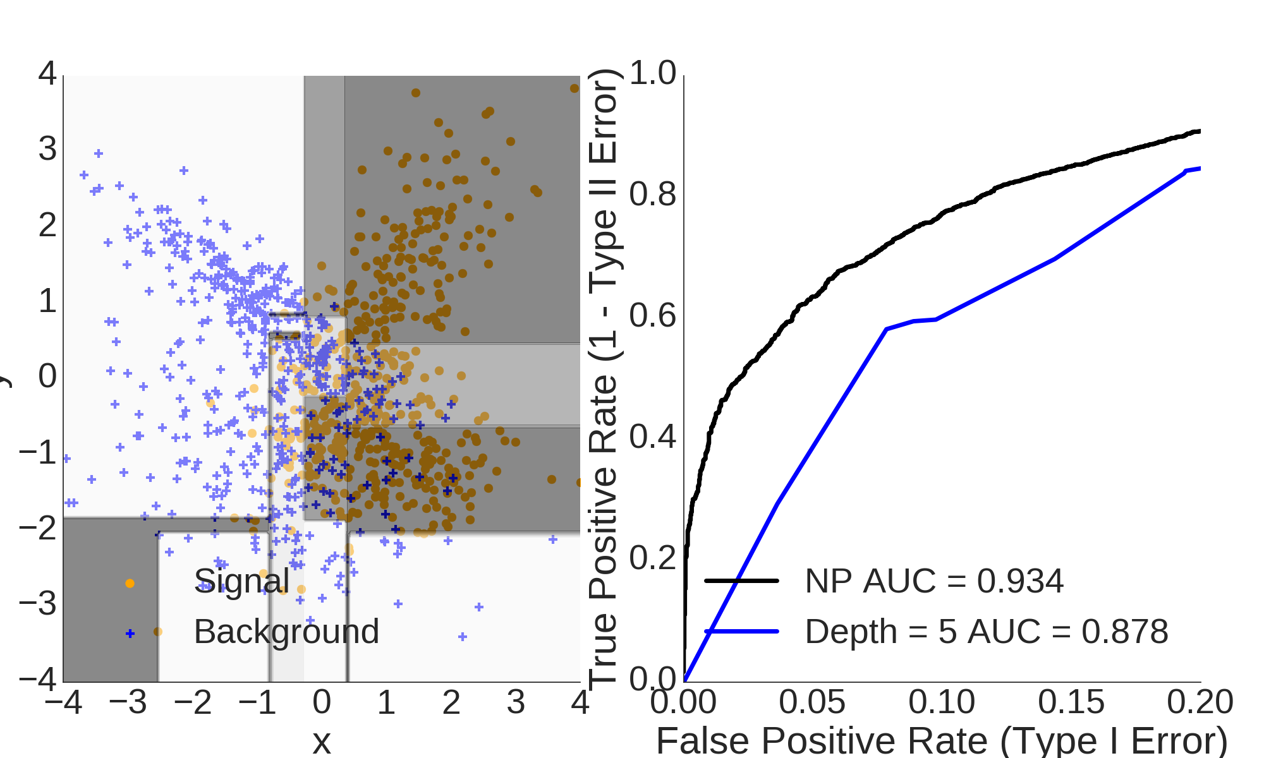
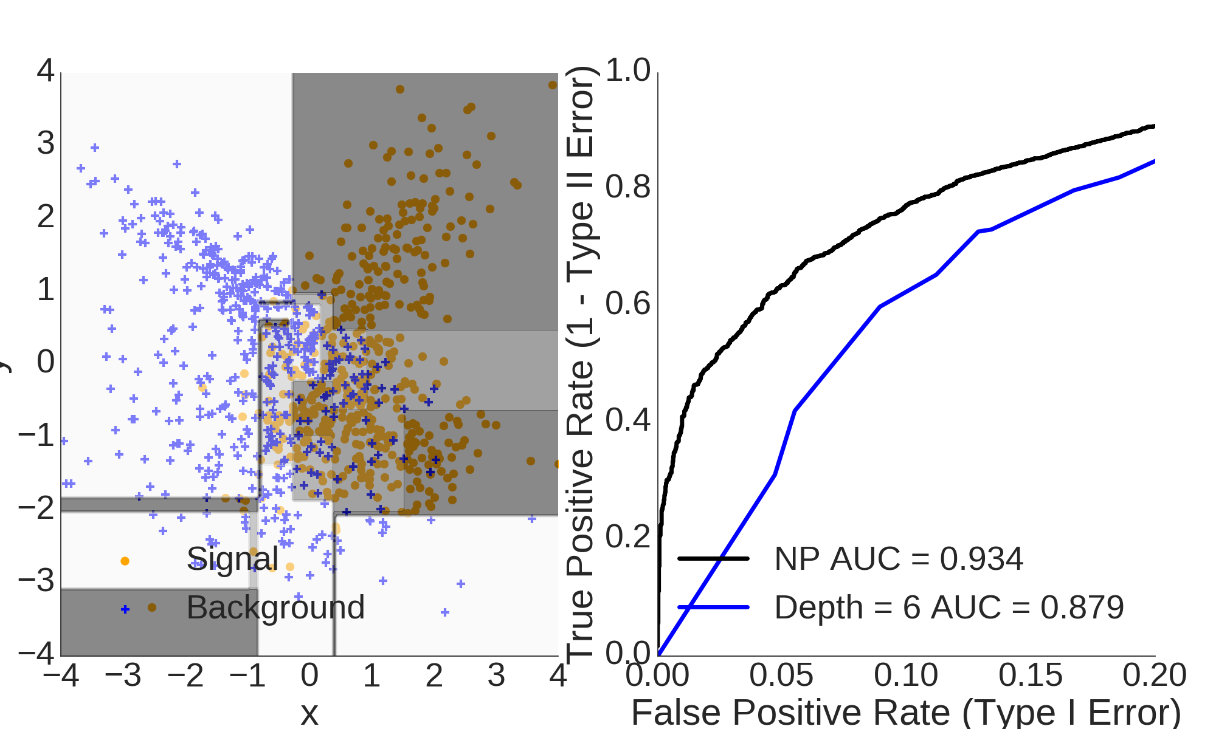
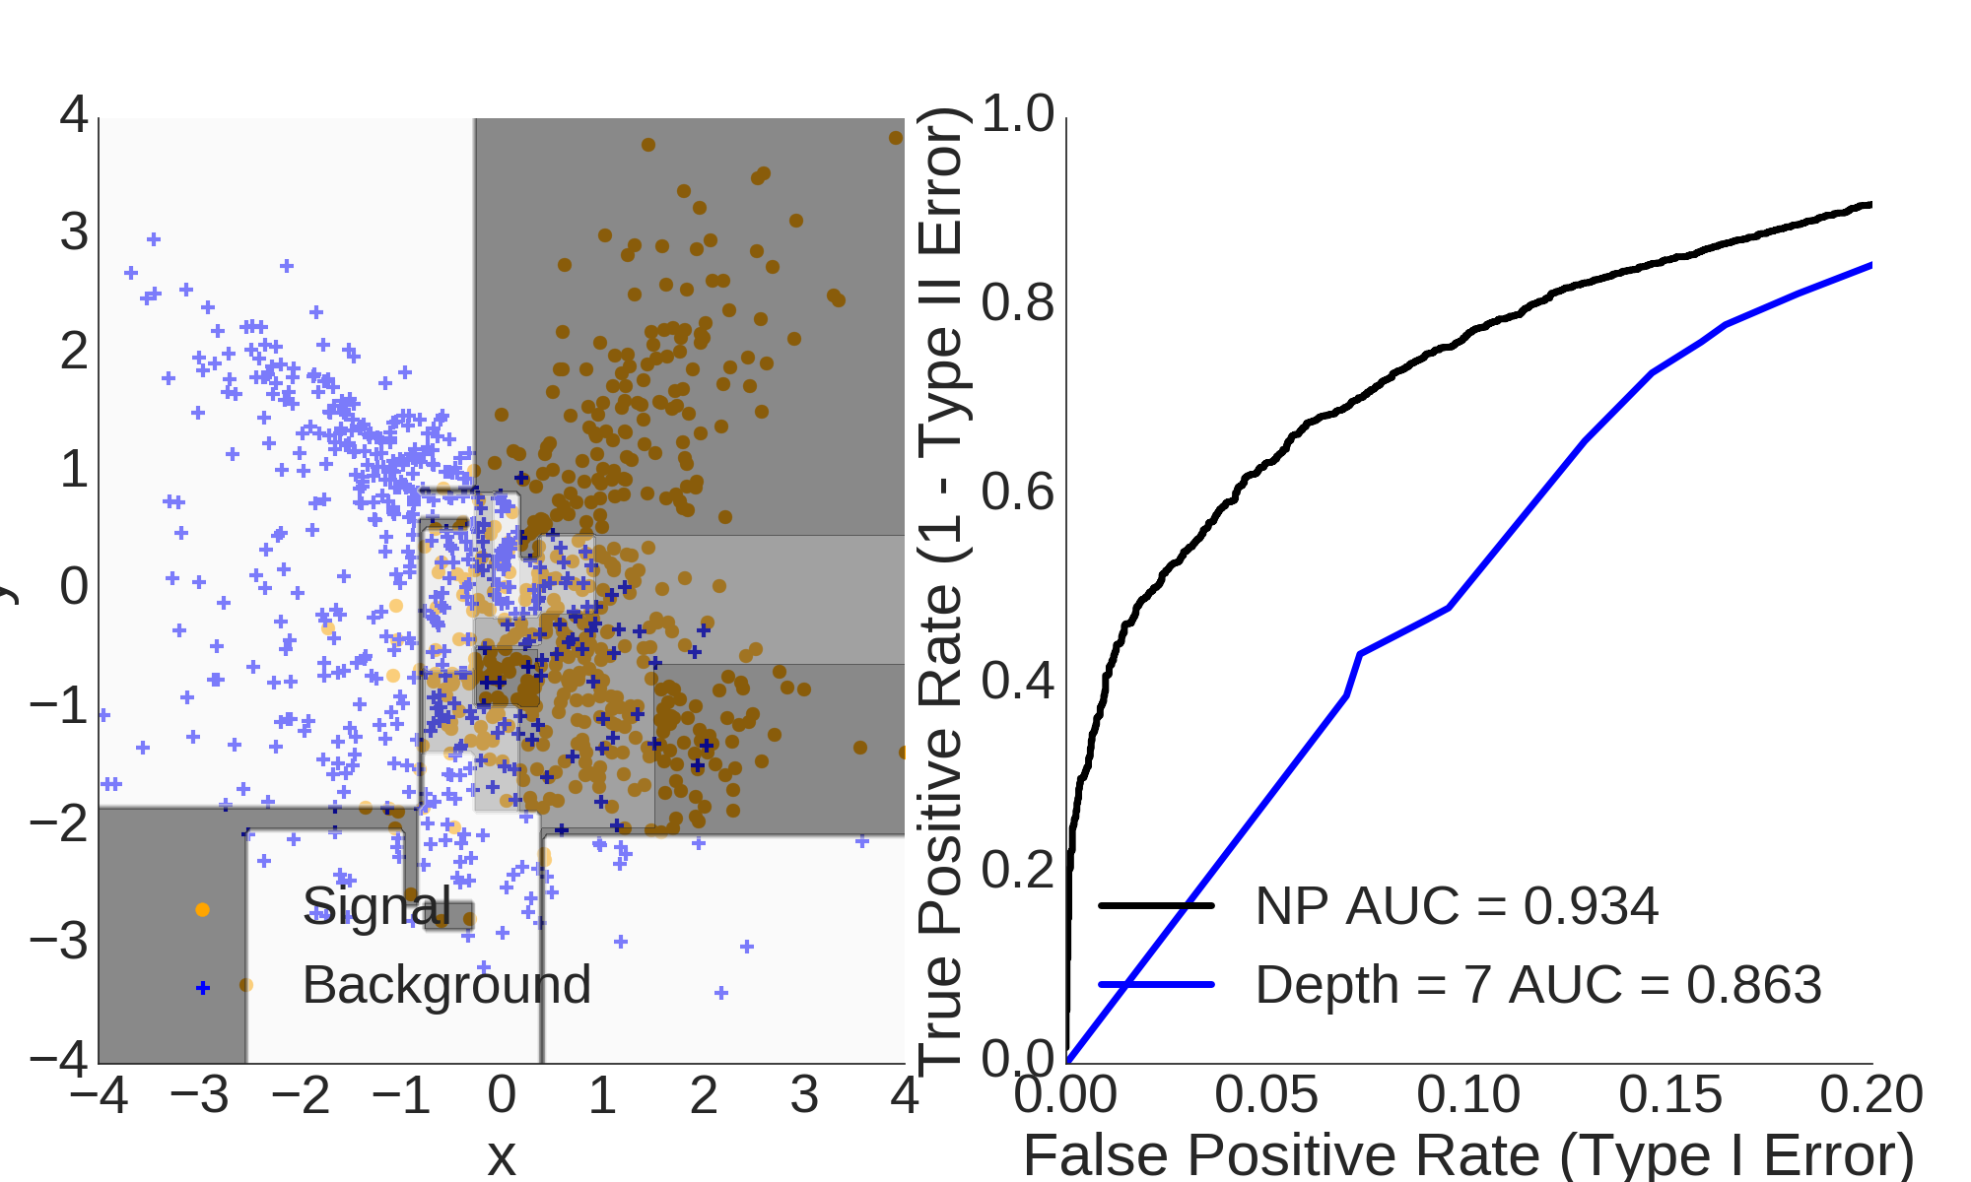
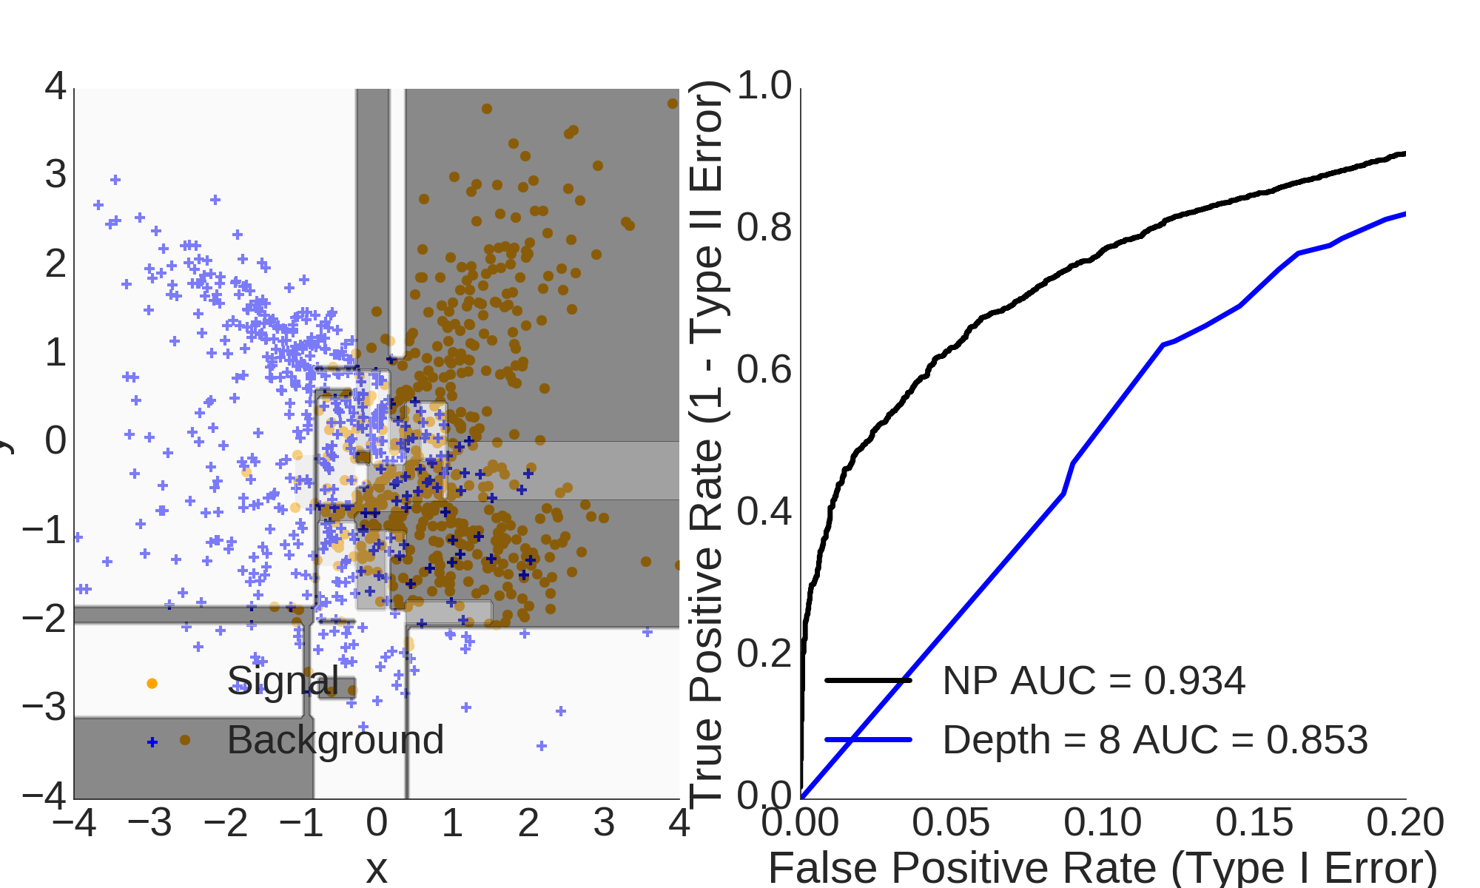
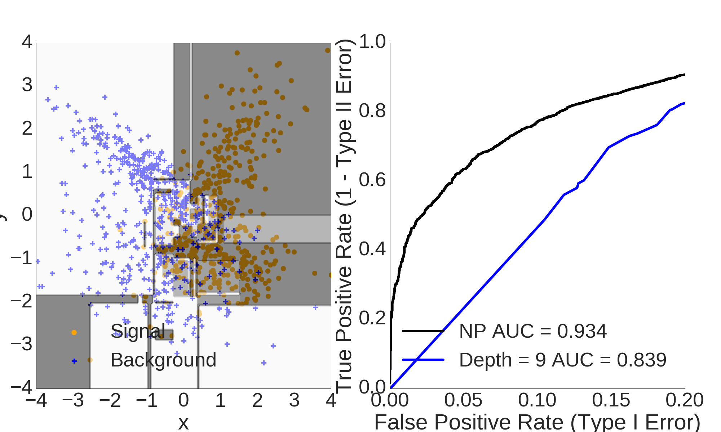
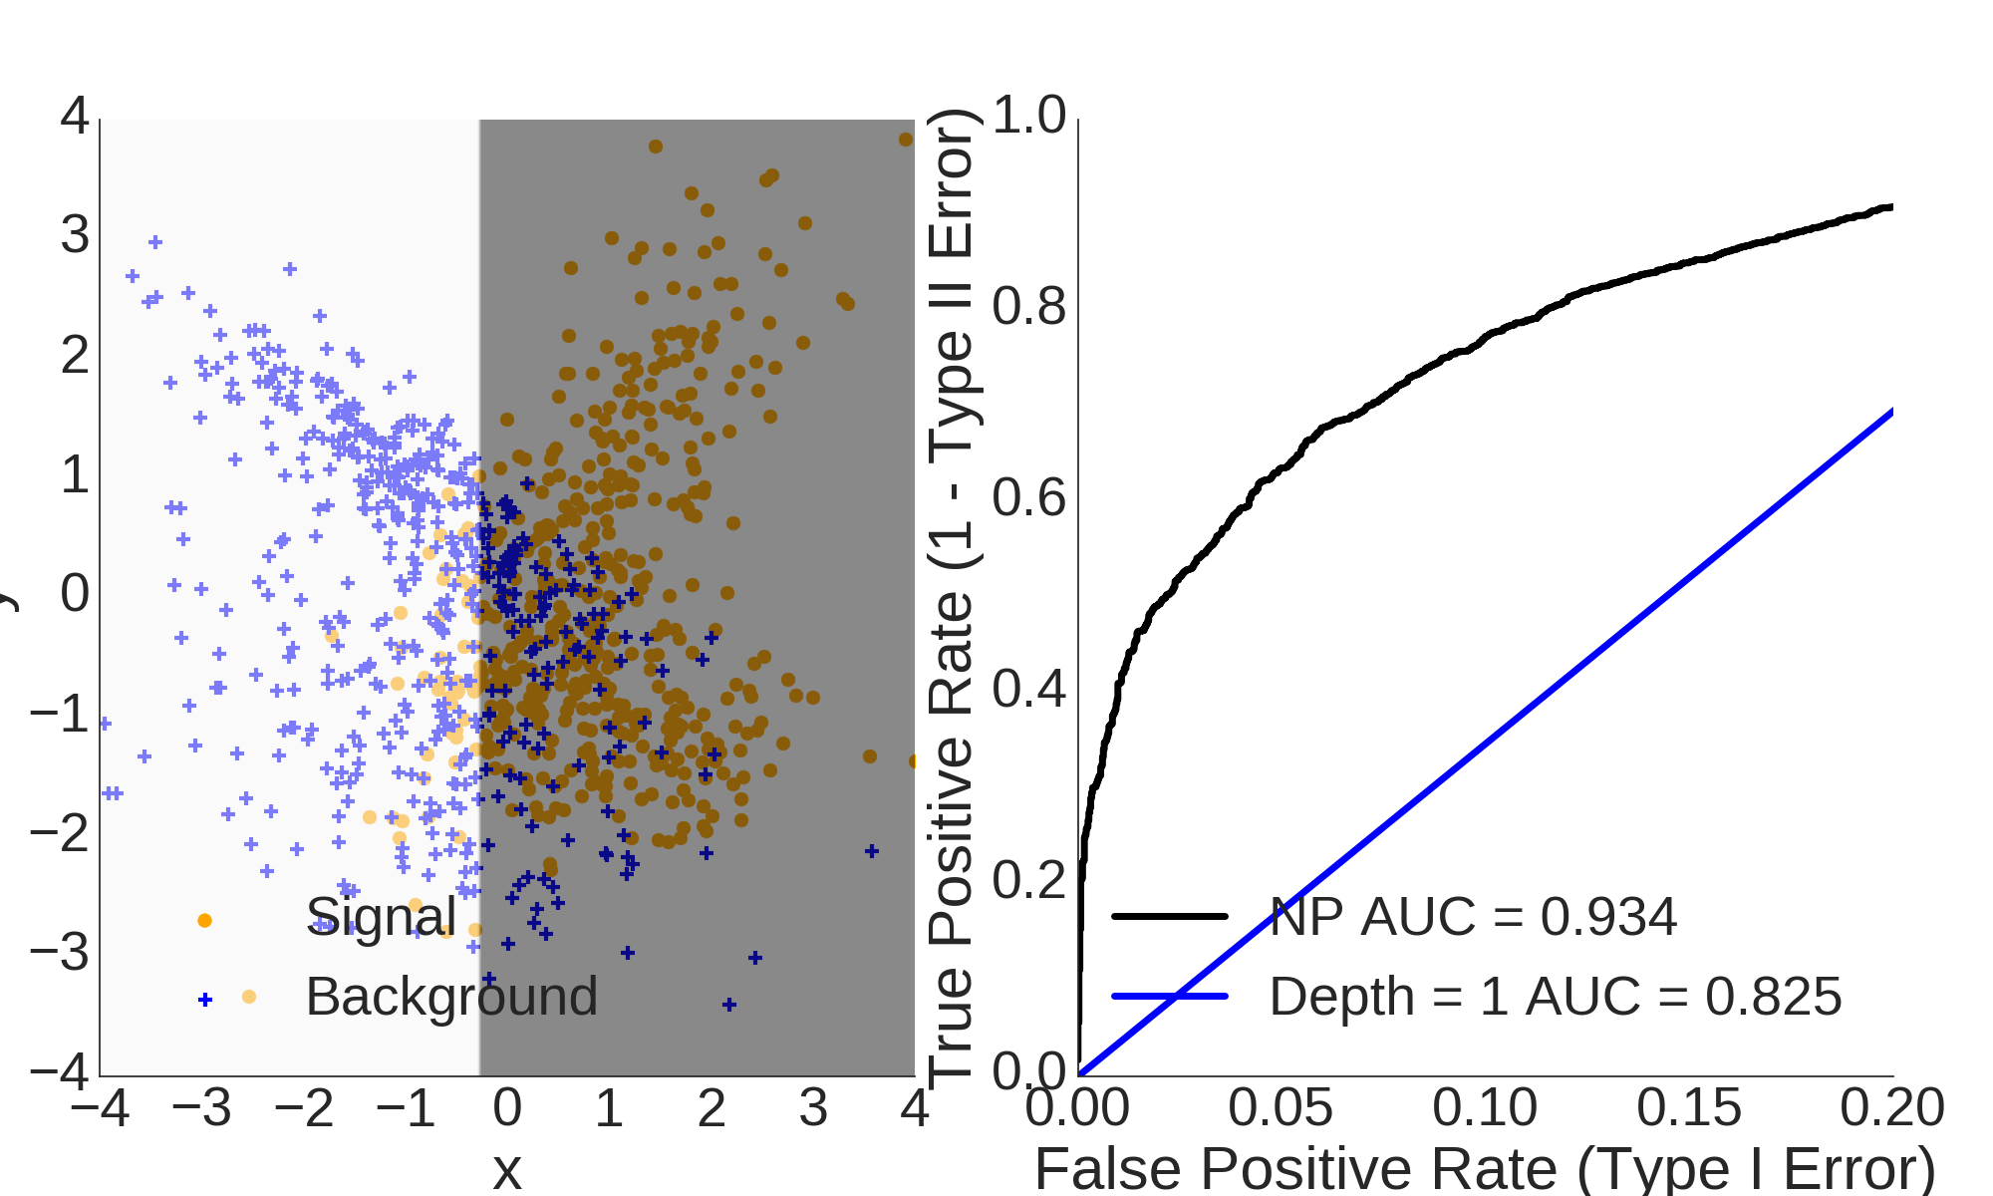
Decision Tree

Slide 26
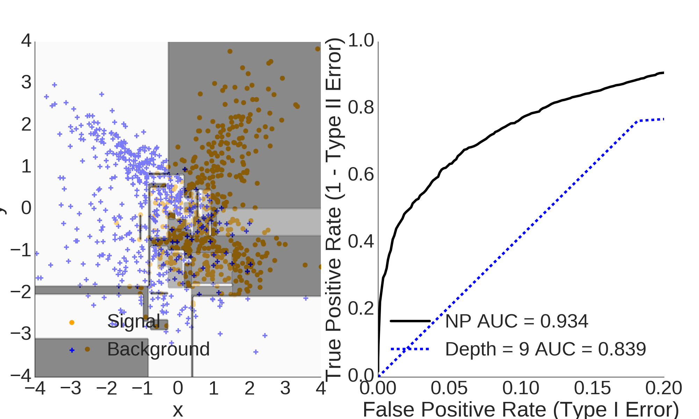
Overfitting
Model is too complex
Statistical fluctuations in the training data dominate predictions
Model does not generalize → poor performance on new data

Slide 27
Underfitting
Model is too simple
Relevant aspects of the data are ignored

Slide 28
Model Complexity
Hyperparameters control the model complexity
Maximal depth of a decision tree
Number of trees in a boosted decision tree
Number of hidden neurons in an artifical neural network
Soft margin parameter in a support vector machine
Optimize hyperparameter to get best performance on new data
Grid-Search using additional test-sample or cross-validation
Bayesian methods can automatically determine optimal value
Always test on independent validation sample in the end!
Notes:
http://blog.kaggle.com/wp-content/uploads/2015/04/iris_petal_sepal.png
http://mirlab.org/jang/books/dcpr/dataSetIris.asp?title=2-2%20Iris%20Dataset

Slide 29
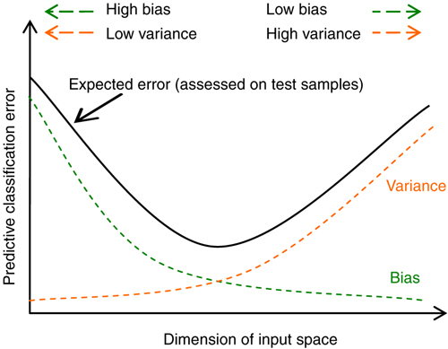
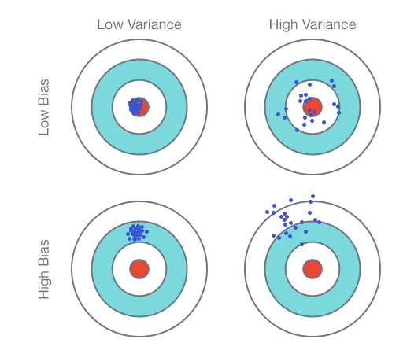
Model Complexity
Regularisation methods reduce effective model complexity
Pruning of a decision tree or neural network
Weight decay in an artifical neural network
Ensemble methods
Notes:
http://blog.kaggle.com/wp-content/uploads/2015/04/iris_petal_sepal.png
http://mirlab.org/jang/books/dcpr/dataSetIris.asp?title=2-2%20Iris%20Dataset
http://www.nature.com/bjc/journal/v98/n6/images/6604207f1.jpg

Slide 30
Boosted Decision Trees / Ensemble methods

Slide 31
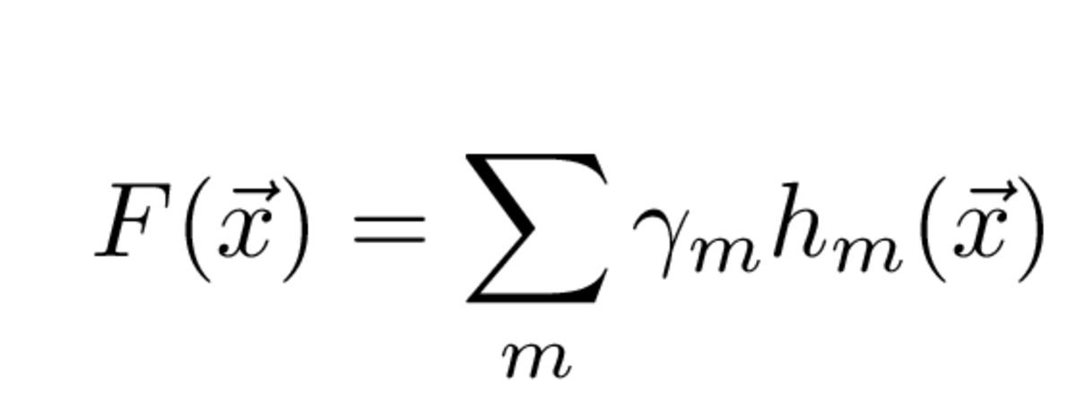
Ensemble methods
Idea: Average many simple models to obtain a robust complex model
Notes:
http://blog.kaggle.com/wp-content/uploads/2015/04/iris_petal_sepal.png
http://mirlab.org/jang/books/dcpr/dataSetIris.asp?title=2-2%20Iris%20Dataset

Slide 32
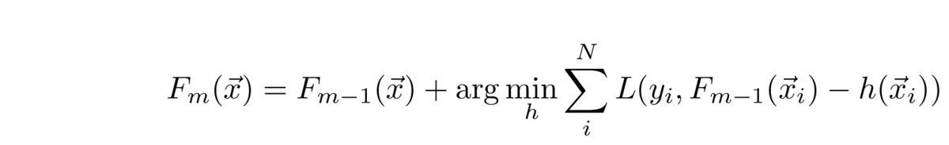
Boosting
Training Sample
classifier
F⁽⁰⁾(x)
Reweight events according to current prediction
Individual classifiers are simple to avoid overfitting (weak-learners)
Concentrate on events near the optimal separation hyper-plane
Loss Function L is crucial
Least square → Regression
Binomial deviance → Gradient Boost Classification
Exponential loss → AdaBoost Classification
Weighted Sample
classifier
F⁽¹⁾(x)
Weighted Sample
classifier
F⁽²⁾(x)
Weighted Sample
classifier
F⁽³⁾(x)
Weighted Sample
classifier
F^{(m)}(x)

Slide 33
Bagging
Training Sample
Sub-Sample
Sub-Sample
Sub-Sample
classifier F⁽¹⁾(x)
classifier F⁽²⁾(x)
classifier F^{(m)}(x)
Bagging – Use only fraction of events / features per classifier
Robustness against statistical fluctuations in the data
Sampling Method is crucial:
Draw random events with replacement → Bagging
Draw random events without replacement → Pasting
Draw random features → Random Subspaces

Slide 34
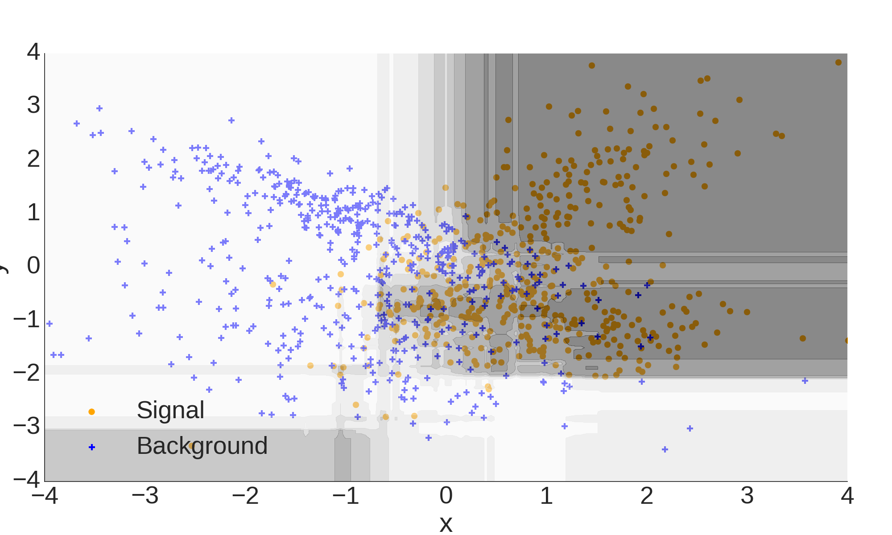
Stochastic Boosted Decision Trees

Slide 35
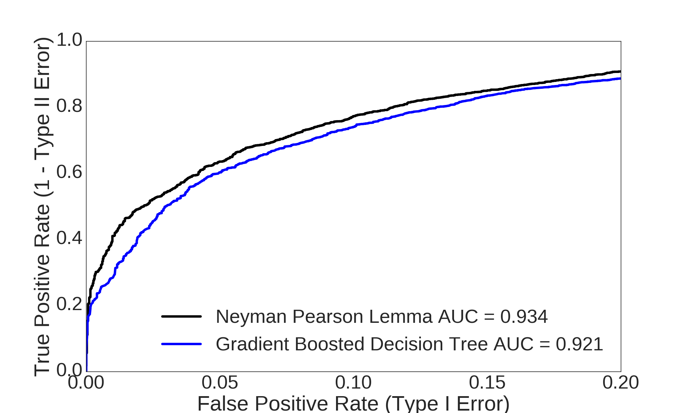
Stochastic Boosted Decision Trees
BDTs perform really well out of the box!

Slide 36

Further Ensemble Methods
Categorisation – Divide feature-space into sub-spaces
Different mechanisms and processes in the chosen subspaces e.g. train separate classifiers for Barrel and Endcap regions
Combination – Combine different classifier
Different regularisation methods learn different aspects of the data e.g. Combine neural network, boosted decision tree and SVM
Notes:
http://blog.kaggle.com/wp-content/uploads/2015/04/iris_petal_sepal.png
http://mirlab.org/jang/books/dcpr/dataSetIris.asp?title=2-2%20Iris%20Dataset

Slide 37
Support Vector Machines / Kernel trick

Slide 38

SVM

Slide 39

Linear SVM

Slide 40


Kernel Trick
SVM Algorithm depends only on scalar product!
Replace scalar product with an arbitrary kernel function

Slide 41

RBF SVM

Slide 42

Poly SVM

Slide 43

Performance strongly depends on kernel

Slide 44
Sideband subtraction & sPlot / Data-driven techniques

Slide 45






Data driven techniques
Control variable
Discriminating variable
Control variable
Control variable
Control variable
Control variable

Slide 46

Side-band Subtraction
Requires # of Signal Events in Signal Region
Compensates Background Events in the Signal Region with negative Signal Events from the Sideband

Slide 47


sPlot
Requires yields and covariance of fitted signal + background models
Uses every event twice, as signal and as background with the correct weight

Slide 48

Classification Quality
DOI: 10.1111/j.1469-1809.1936.tb02137.x
Use data-driven techniques
if your don't trust you simulated data

Slide 49
Reweighting
Requires MC and data events
Trains classifier to distinguish data events and MC events
Reweighted MC Events using output of classifier
Trains classifier to distinguish signal and background using reweighted MC

Slide 50
Available tools

Slide 51





Python, scipy and sklearn

Slide 52



C++, ROOT and TMVA
Redesign: http://oproject.org/TMVA

Slide 53

Notes:
The winning submission was a bag of 70 dropout neural networks and took one day to train on a GTX Titan GPU in double precision mode. Prediction took about an hour.

Slide 54

HEP vs. MML community
„How to bring Modern Machine Learning to HEP“ by Tobias Golling, University of Geneva
at "ROOT turns 20” Users’ Workshop, Saas-Fee, September 15-18 2015

Slide 55
Multivariate Classification and Machine Learning in HEP
Lecture 2
Deep learning
Thomas Keck
IEKP KIT
Inverted CERN School of Computing, 29 February – 2 March 2016

Slide 56
Outline
Artificial neural networks
Highlights
Driving factors of Deep Learning
Convolutional neural network
Recurrent neural network
Available tools

Slide 57
Artificial neural networks

Slide 58
Artificial neural networks

Slide 59





Artificial neural networks
Feed Forward
Backpropagation

Slide 60

Artificial neural networks

Slide 61

Artificial neural networks
Perform as well as BDTs
Typically more difficult to tune

Slide 62
Workflow
Data acquisition
Experiment
Simulation
3rd party
Data preparation
Calibration
Remove outliers
Suppress noise
Data preprocessing
Feature extraction
Data reduction
Train classifier
Calculate parameters / weights
Optimize hyper-parameters
Apply classifier
On independent sample
Validate classifier
Evaluate performance
Estimate systematics / bias
Deploy classifier in production

Slide 63

Deep Learning
Idea: Feed in low level features → Feature extraction is done automatically

Slide 64

Deep Learning
Luke de Oliveira

Slide 65
Highlights

Slide 66



Deep neural network outperforms BDTs
DN 0.88
BDT 0.81

Slide 67


Extract information using convolution neural network
Generate description using recurrent neural network

Slide 68


Slide 69

Bilbo travelled to the cave. Gollum dropped the ring there. Bilbo took the ring. Bilbo went back to the Shire. Bilbo left the ring there. Frodo got the ring. Frodo journeyed to Mount-Doom. Frodo dropped the ring there. Sauron died. Frodo went back to the Shire. Bilbo travelled to the Grey-havens. The End.
Where is the ring? A: Mount-Doom
Where is Bilbo now? A: Grey-havens
Where is Frodo now? A: Shire

Slide 70


Receiving only the pixels and the game score as inputs, achieved a level comparable to that of a professional human games tester across a set of 49 games, using the same algorithm, network architecture and hyperparameters.

Slide 71
Driving Factors of Deep Learning

Slide 72

1. Big Data
Deep Learning needs high statistics!

Slide 73

2. GPU Acceleration
Deep Learning needs a lot of computation time!

Slide 74






3. New Deep Learning Techniques
Vanishing Gradient Problem → ReLU
Dropout Regularisation
https://commons.wikimedia.org/wiki/File:Alexnet.svg
Long Short-Term Memory
Restricted Boltzman Machines

Slide 75
Convolutional Neural Network

Slide 76

Tasks
http://xkcd.com/1425/

Slide 77






Problem
Lots of different birds in different poses, scales, positions!

Slide 78
Invariance under Transformations
We can think of different strategies to build a classifier which is invariant under certain transformations of its input
Use copies of same image with arbitrary translation, rotation and scaling during the training phase
Add term to Loss-Function that penalizes changes in the model output when input is transformed → Tangent propagation
Extract hand-crafted features that are invariant under the transformation
Build invariance properties into structure of neural network → local receptive fields, shared weights and subsampling

Slide 79

Convolutional Neural Network
http://parkorbird.flickr.com/
Convolution layer: Organized in planes called feature maps
Learnable filters (e.g. edge detector)
All units take inputs only from small subregion of the image
All units are constrained to share the same weights
→ All units detect same pattern but in different locations

Slide 80
Convolutional Neural Network
http://parkorbird.flickr.com/
Pooling Layer:
Take inputs from small receptive field in the feature maps
Perform subsampling by weighted average + activation function
→ Insensitive against small shifts

Slide 81
Convolutional Neural Network
http://parkorbird.flickr.com/
Architecture: Multiple pairs of convolution + pooling layers
Each stage has a larger degree of invariance to input transformations
Gradual reduction in resolution compensated by increasing number of features
Final layer typically fully connected with softmax output for multiclass classification

Slide 82
Limitations
Fixed input space dimension
Howto process sequential data like speech or text?
Computationally expensive because the amount of computation scales linearly with the number of image pixels

Slide 83
Recurrent Neural Network

Slide 84


Recurrent Neural Network

Slide 85
Long Short-Term Memory
Can remember a value for a long time period
Input gate decides when to update the stored value
Output gate decides when to output the stored value
Forget gate decides when to forget the stored value
→ Can process sequential data (e.g. text and speech)

Slide 86

Character level language model
http://karpathy.github.io/2015/05/21/rnn-effectiveness/

Slide 87


Applied on C-Code
http://karpathy.github.io/2015/05/21/rnn-effectiveness/
Linux Kernel Code on Github (474 MB)
3-layer LSTMs (~10 million parameters)
Few days training time on graphic card
Learned syntax, but not semantic
Cell that activates inside if statements

Slide 88

Recurrent Models of Visual Attention
http://arxiv.org/abs/1406.6247
http://arxiv.org/abs/1412.7755
Scans image using recurrent neural network
Trained using reinforcement learning methods
Attention models successfully employed for handwriting recognition

Slide 89
Available Tools

Slide 90






